Slide 1
Las Vegas and Popular Culture
Lecture 12 of 12
by Dr. Loren Lerner, Department of Art History, Concordia University, Montreal
Special thanks to Serena Desaulniers, editing and technical assistant

Slide 2
Las Vegas as a Casino City | OUTLINE
EDWARD E. BALDWIN ON LAS VEGAS IN POPULAR CULTURE (1996)
LAS VEGAS AND POPULAR MAGAZINES
LAS VEGAS AND POPULAR FILMS
Notes:
Outline
Las Vegas and Popular Magazines
Las Vegas and Popular Films

Slide 3
EDWARD E. BALDWIN ON
LAS VEGAS IN POPULAR CULTURE (1996)

Slide 4
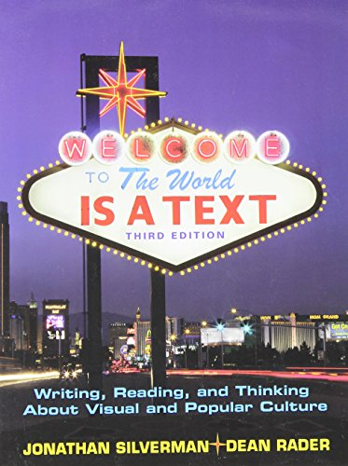
An examination of the depictions of Las Vegas in popular culture reveals two major strains of interpretation. First, it is apparent that certain aspects of the city reassert themselves over time. These aspects include gambling, the frontier, and the description of real and imagined structures (such as Caesars Palace) which reflect the values of Las Vegas. A second strain of interpretation growing along with the city shows the way each decade brings new concerns. Novels, magazine articles, short stories television programs and films provide snapshots of specific moments in the popular culture of Las Vegas. This presentation will focus on two types of popular culture productions: popular magazines and films.

Slide 5
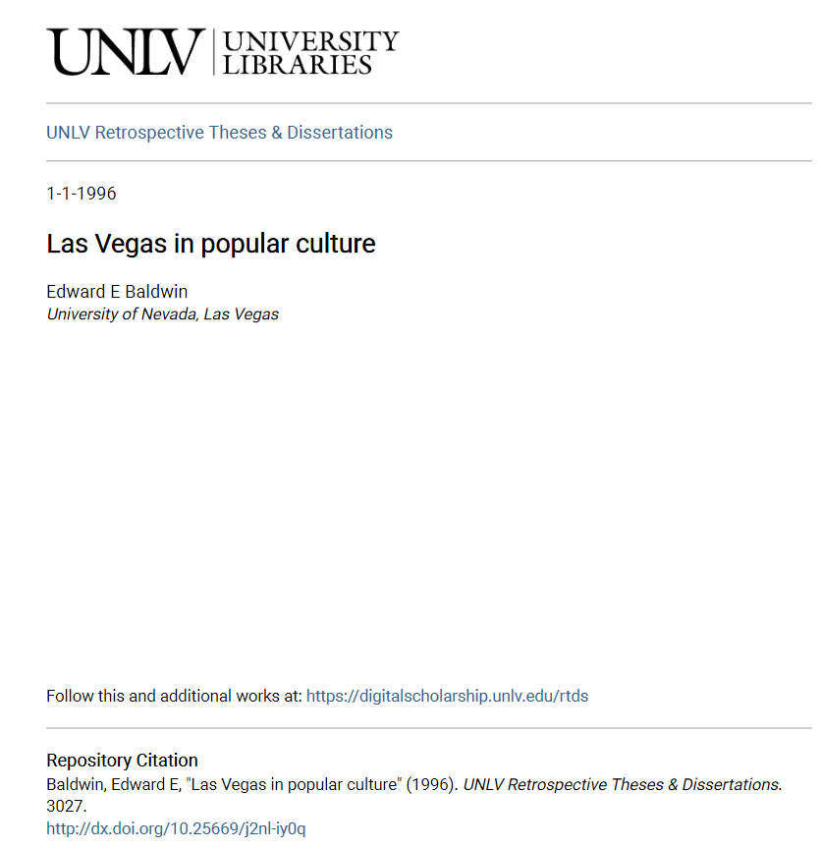
The main source of this presentation on Las Vegas and Popular Culture is this dissertation by Edward E. Baldwin. ​
​
Baldwin provides "a survey and analysis of the depiction of Las Vegas in American popular culture. The dissertation identifies themes and patterns of interpretations of Las Vegas, a city which has come to occupy a central position in popular American mythology. The primary emphasis is on nationally published novels, short stories, and magazine articles, with a section on films. The material is evaluated in chronological order so that the depictions of Las Vegas can be seen in their historical contexts. Since the 1930s, writers in each succeeding decade emphasize different aspects of Las Vegas which correspond to contemporary events in the evolution of the city and of the society. Both the fictional and non-fictional accounts of Las Vegas reflect this evolution, so the writing, reading, thinking and visualization of popular culture can be seen as a continuing commentary on the unfolding story of America's fastest-growing city."
https://digitalscholarship.unlv.edu/cgi/viewcontent.cgi?article=4026&context=rtds

Slide 6
LAS VEGAS IN POPULAR MAGAZINES

Slide 7
Photo-essays in magazines popularized the news by telling the story at a glance. The photographs invited viewers' attention and convinced them of the story's accuracy. The words reinforced the apparent truthfulness of the photographs. The photo-essay, as it appeared in magazines of the 1940s to 1960s crystallized American facts and symbols and ideals. The popular photographer had two avenues of expression that were socially acceptable: 1) the camera’s focus on subjects of beauty and 2) the camera’s usage to make socially conscious statements. ​
​
Life Magazine was a popular source of visual news because of its innovative uses of photography. It was in a unique position to influence and transform modes of vision within the more privileged sectors of the United States. The magazine helped to create class, national, and consumer consciousness, as well as the particular politics it attached to those strategies. In this presentation the photo-essays in Life and other popular magazines from the 1940s to the 1960s are presented in chronological order so that the depictions of Las Vegas can be seen in their historical contexts.

Slide 8
"Las Vegas Gambling." Life 13 no. 25 (Dec. 21, 1942): 91-94.

Slide 9
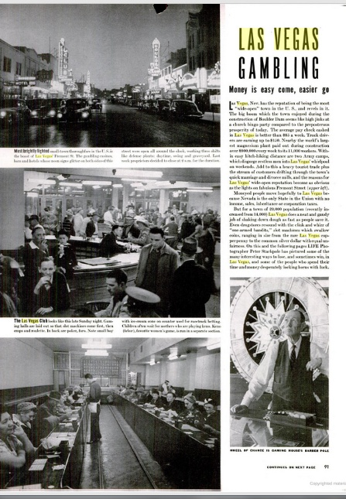
Questions of social justice and morality emerge in the long, often strained, relationship between Life and Las Vegas. This begins in 1942, with a photo spread entitled "Las Vegas Gambling."

Slide 10
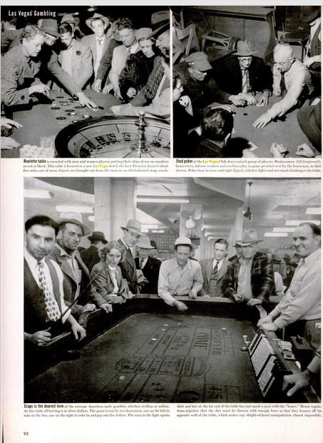
There are interior shots of the Las Vegas club and the Frontier which look startlingly low-rent to the modem observer; exposed fluorescent lighting and structural beams make these buildings look more like run-down WalMarts than recreational areas. The text accompanying the photographs explains that "The big boom which the town enjoyed during the construction of Boulder Dam (later renamed Hoover Dam) seems like high jinks at a church bingo party compared to the preposterous prosperity of today."

Slide 11
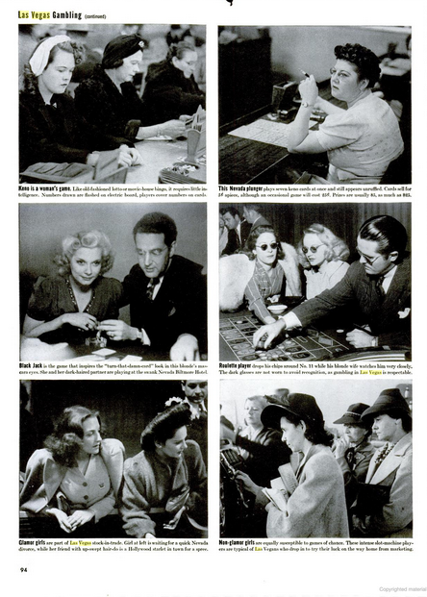
Never without some kind of agenda, this time Life adopts a curiously misogynistic tone in captions such as these: "Keno is a woman's game. Like old-fashioned lotto or movie-house bingo, it requires little intelligence" (94).

Slide 12
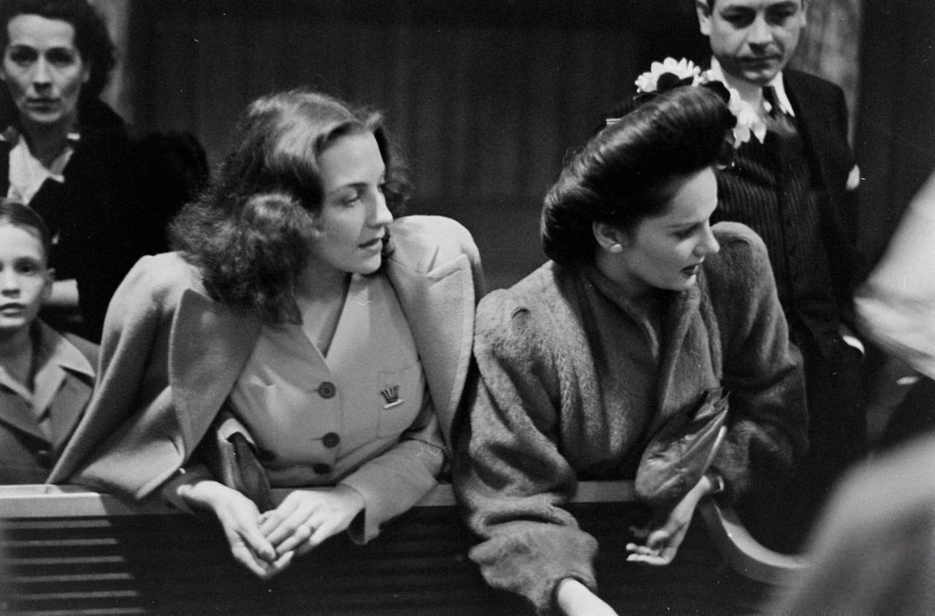
Two women juxtaposed next to each other bear this caption: "Glamor girls are part of Las Vegas stock-in-trade. Girl at left is waiting for a quick Nevada divorce, while her friend with the up-swept hair-do is a Hollywood starlet in town for a spree." This article establishes a pattern of interpretation which will characterize Life's coverage for decades to come; the magazine always carries an undercurrent of condemnation in its supposedly objective journalism.

Slide 13
"Las Vegas Strikes it Rich." Life 22 no. 21 (May 26,1947): 99-105.

Slide 14
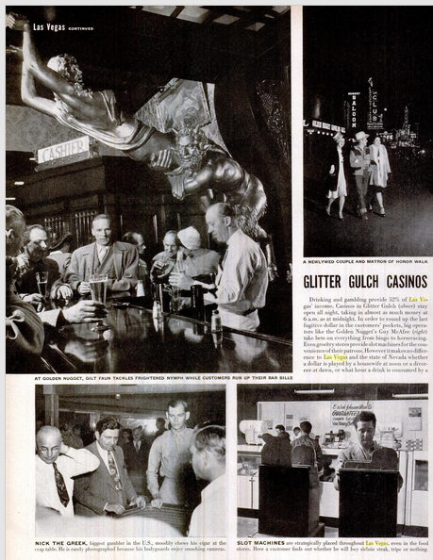
In 1947 Life returned for "Las Vegas Strikes it Rich," which attributed "the big boom" to "the union between the postwar mood of the U.S. and the willing statutes of Nevada, which provide for legal gambling, all-night drinking, two-minute marriages and six-week divorce" (99).

Slide 15
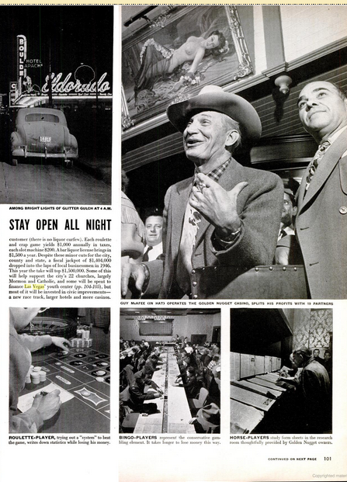
The moral prod here is in Life's reporting that "Slot machines are strategically placed throughout Las Vegas, even in the food stores. Here a customer finds out whether he will buy sirloin steak, tripe, or nothing" (100). The prose takes on a sardonic tone when Life reports that "This year the [gambling] take will top $1,500,000. Some of this will help support the city's 22 churches, largely Mormon and Catholic, and some will be spent to finance Las Vegas' youth center, but most of it will be invested in civic improvements—a new race track, larger hotels and more casinos" (101).​

Slide 16
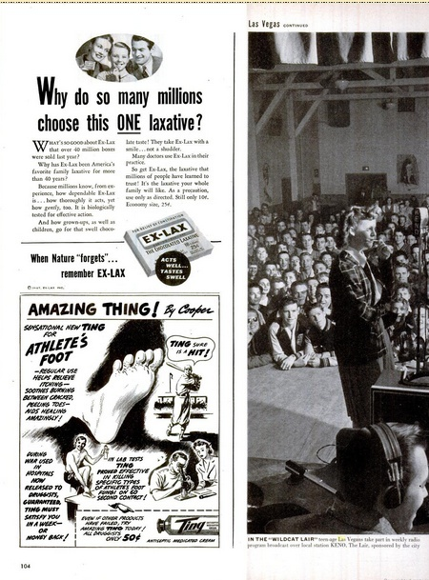
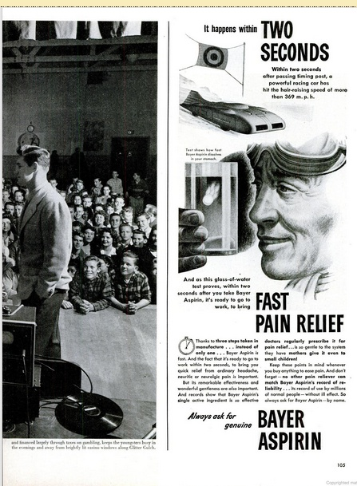
To keep the youngsters away from the "brightly lit casino windows along Glitter Gulch," the article notes a youth-oriented radio show on KENO, "sponsored by the city and financed largely through taxes on gambling" (104-5). It is as if the dark forces of gambling are being called upon to do something—anything—about the moral climate they engender, and Life is sure to keep after them to make sure it is done.

Slide 17
1950s

Slide 18
Saturday Evening Post (May 26, 1956).

Slide 19
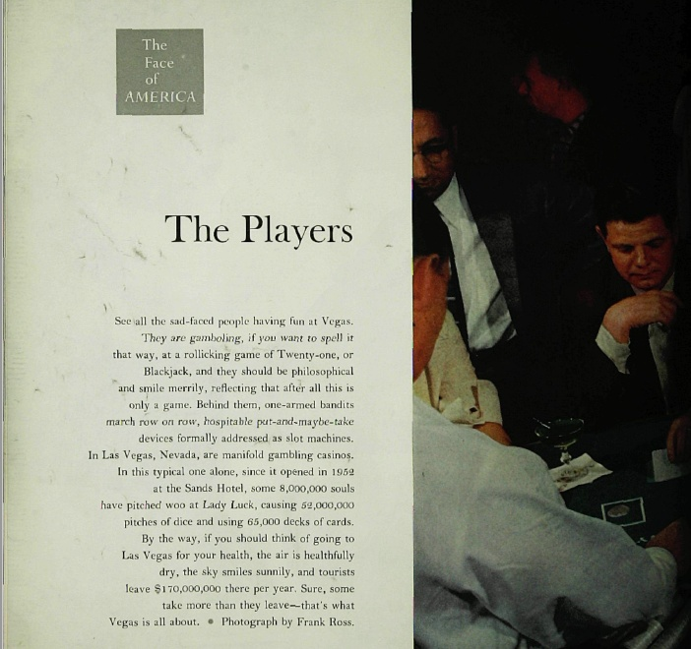
The tone was not only typical of Life . The writer for this article on Las Vegas in
Saturday Evening Post in 1956 writes:
"See all the sad faced people having fun at Vegas. hey are 'gambooling' if you want to spell it that way at a rollicking game of Twenty-one, or Blackjack, and they should be philosophical and smile merrily, reflecting that after all this is only a game. Behind them, one-armed bandits march row in a row… formally addressed as slot machines."

Slide 20
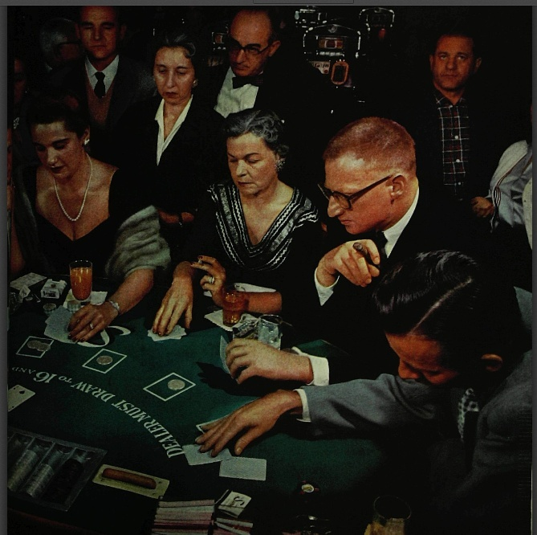
"In Las Vegas, Nevada, there are manifold gambling casinos. In this typical one alone, since it opened in 1952 at the Sands Hotel, some 8,000,000 souls have pitched woo at Lady Luck, causing 52,000,000 pitches of dice and using 65,000 decks of cards. By the way, if you should think of going to Las Vegas for your health, the air is healthfully dry, the sky smiles sunny, and tourists leave $170,000,000 there per year. Sure, some take more than they leave—that's what Vegas is all about."

Slide 21
"Gamblers' Gala." Life 34 no. 7 (February16,1953): 105-11.

Slide 22
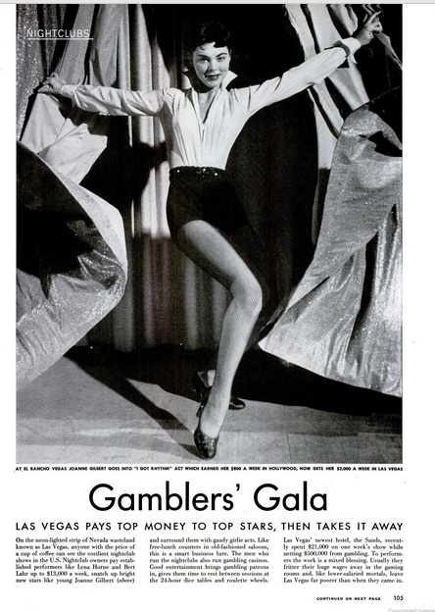
After setting the scene of a place unlike any other in America, many magazines reported that Las Vegas was the place to go for the entertainment dream of a lifetime. The cutting edge of popular culture was out there in the middle of nowhere, and writers expressed wonder and awe at the variety of stars and shows which could be seen. Throughout the 1950s, major magazines such as Time, Newsweek, The Saturday Evening Post, Look, and Life all ran articles about the entertainment opportunities in Las Vegas but always providing a moral viewpoint for its readers.​
​
Life asserted that "to performers the work is a mixed blessing. Usually they fritter their huge wages away in the gaming rooms and, like lower-salaried mortals, leave Las Vegas far poorer than when they came in." The references to "mortals" and to "gold-horned Judas goats" in these articles underscored the public's reverence for their pagan gods which the editors of the magazines were anxious to diffuse.

Slide 23
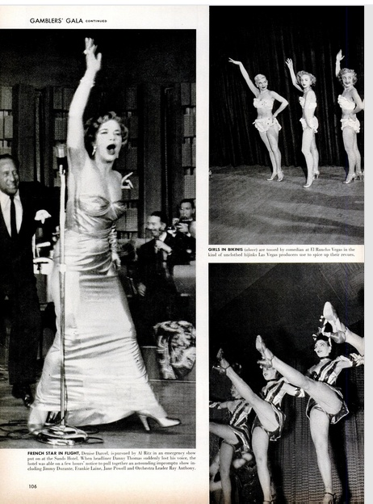
Life's moralistic stance did not, however, prevent it from running an accompanying photograph of girls in a Sahara chorus line, shot from maximum crotch-viewing perspective. ​
​
This is a common technique of critics of Las Vegas: to provide sensational and titillating hints of the city's decadence while affirming traditional middle-class values.

Slide 24
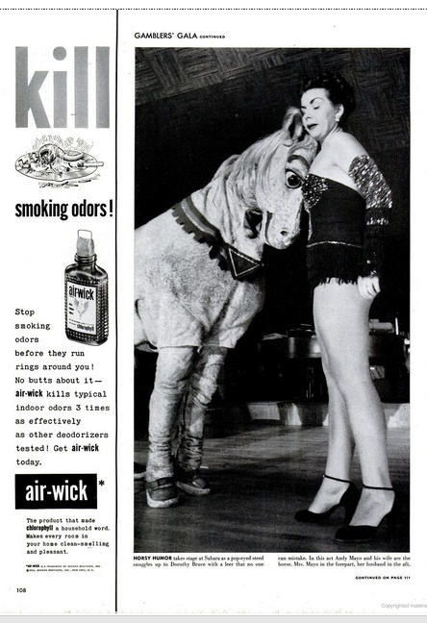
While the most popular names in show business were touted as regular performers in Las Vegas, innovations in entertainment were noted as well. New performers or unique productions were reported on, with the sense that Las Vegas was so jaded that it required continuous novelty to hold the attention of its patrons.​

Slide 25
"Wherever You Look There's Danger in Las Vegas." Life 31 no. 20 (Nov. 12,1951): 37.

Slide 26
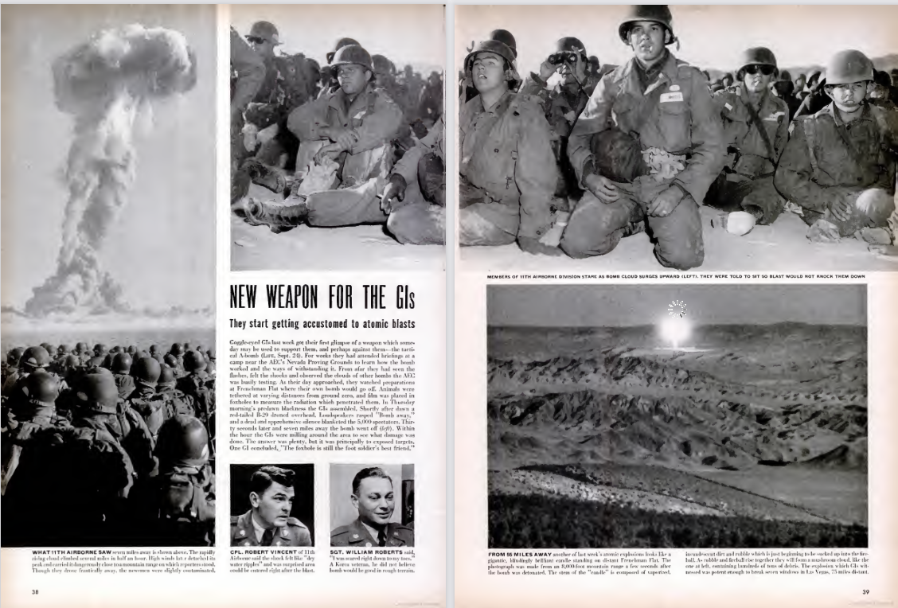
Once the attractions of Las Vegas were described, national attention in the early 1950s turned to an important aspect of the historical period: the atomic bomb testing which occurred just outside the city. Las Vegas' ability to capitalize on any situation was emphasized in most of the coverage, which also made ample use of the obvious metaphor of a big scientific and strategic gamble being played out in this location.

Slide 27
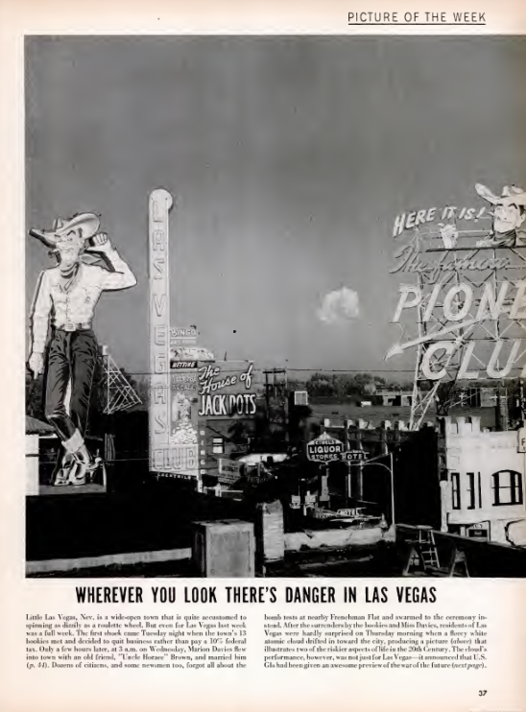
​The link between the town's gambling industry and the bomb was made most explicit in the now-famous photograph, which originally appeared in Life, of a mushroom cloud over the shoulder of Vegas Vic and the Fremont Street skyline, and the caption "Wherever You Look There's Danger In Las Vegas." ​
​
The accompanying text noted that the picture "illustrates two of the riskier aspects of life in the 20th Century." In general, though, the bombs were depicted as yet another spectacle in an already spectacular place.​

Slide 28
"Gambling Town Pushes Its Luck." Life 38 no.25 (June 20,1955): 20-27.

Slide 29
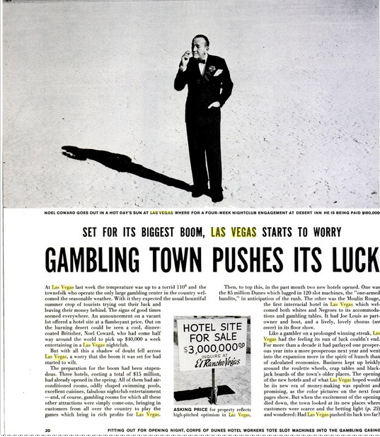
Another concern of the 1950s, and one which gained more circulation as time went on, was the presence of organized crime figures in everyday life.​
​
The Kefauver Committee hearings in 1951 focused attention on this issue in regards to Las Vegas, and the widespread knowledge that Bugsy Siegel played an important role in the city's growth served to increase awareness and interest in gangsters. The political climate of the 1950s may have also contributed to the suspicion of devious forces at work under the surface of things, with the McCarthy hearings and the subsequent "Red Scare" providing grist for the conspiracy-minded.

Slide 30
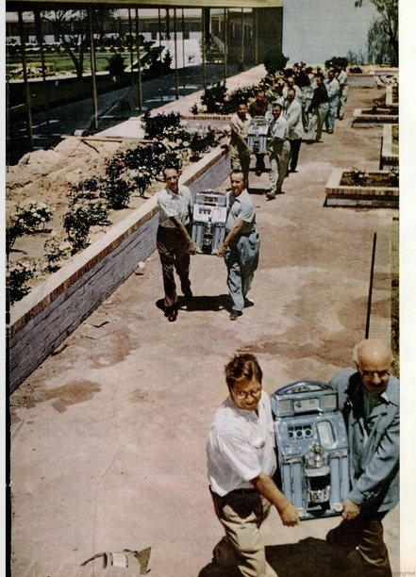
This hostility or ambivalence regarding the moral climate of Las Vegas is evident even in the "straight news" stories which appeared in national magazines in the 1950s. These stories purported to be objective in reporting facts rather than providing description or analysis, but objectivity seems to be close to impossible when Las Vegas is the subject This can be seen in the appearance of several stories which speculated that the boom was about to end, and it was often accompanied by the suggestion that Las Vegas was getting what it deserved.​
​
Life observed that, "like a gambler on a prolonged winning streak Las Vegas had the feeling its run of luck couldn't end..."

Slide 31
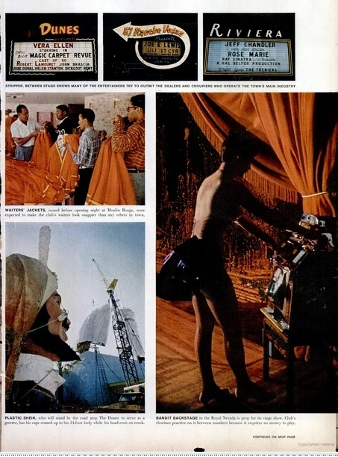
But when the excitement of the opening (of three new hotels in 1955) died down, the town looked at its new places where customers were scarce and the betting light and wondered: Had Las Vegas pushed its luck too far?” (20)

Slide 32
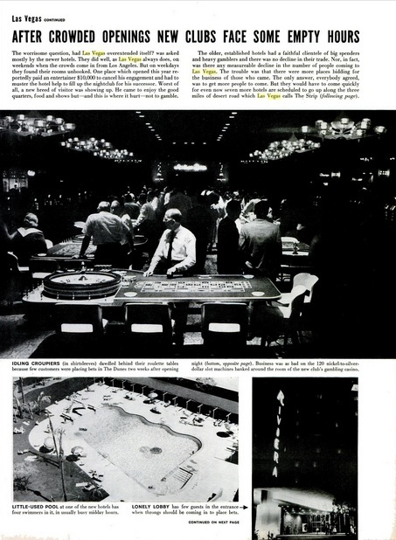
This article was accompanied by pictures of "idling croupiers
dawdl[ing] behind their roulette tables," a "little-used pool," and a "lonely lobby" (25), to show how expectations of packed houses were not being met.

Slide 33
Kenneth Rudeen, "Gambling’s Adult Western," Sports Illustrated May 11, 1959: 24-33.

Slide 34
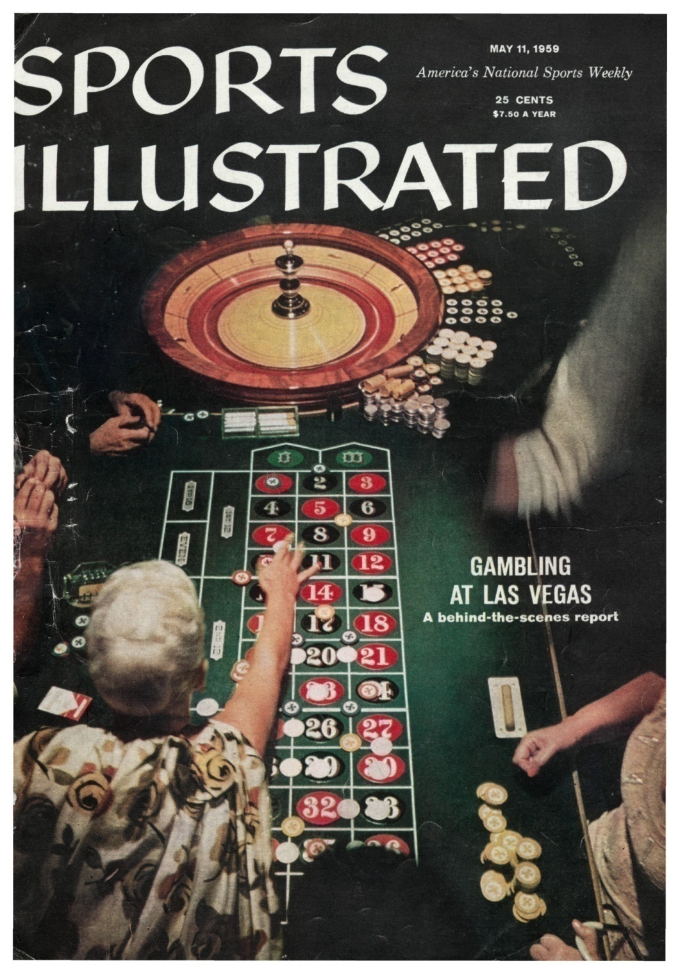
It is possible, however, to come away with two radically opposing viewpoints regarding the influence of gangsters on the Las Vegas scene if one relies upon contemporary accounts. A Sports Illustrated article quoted the Chairman of the Gaming Control Board as saying that "'there are constant rumors of hoods, and when there are we move quickly under the breadth of the law to run these rumors down. Invariably, there is absolutely no proof... Costello, Kastel and Lansky were all either directly or indirectly here for a while—and they left."

Slide 35
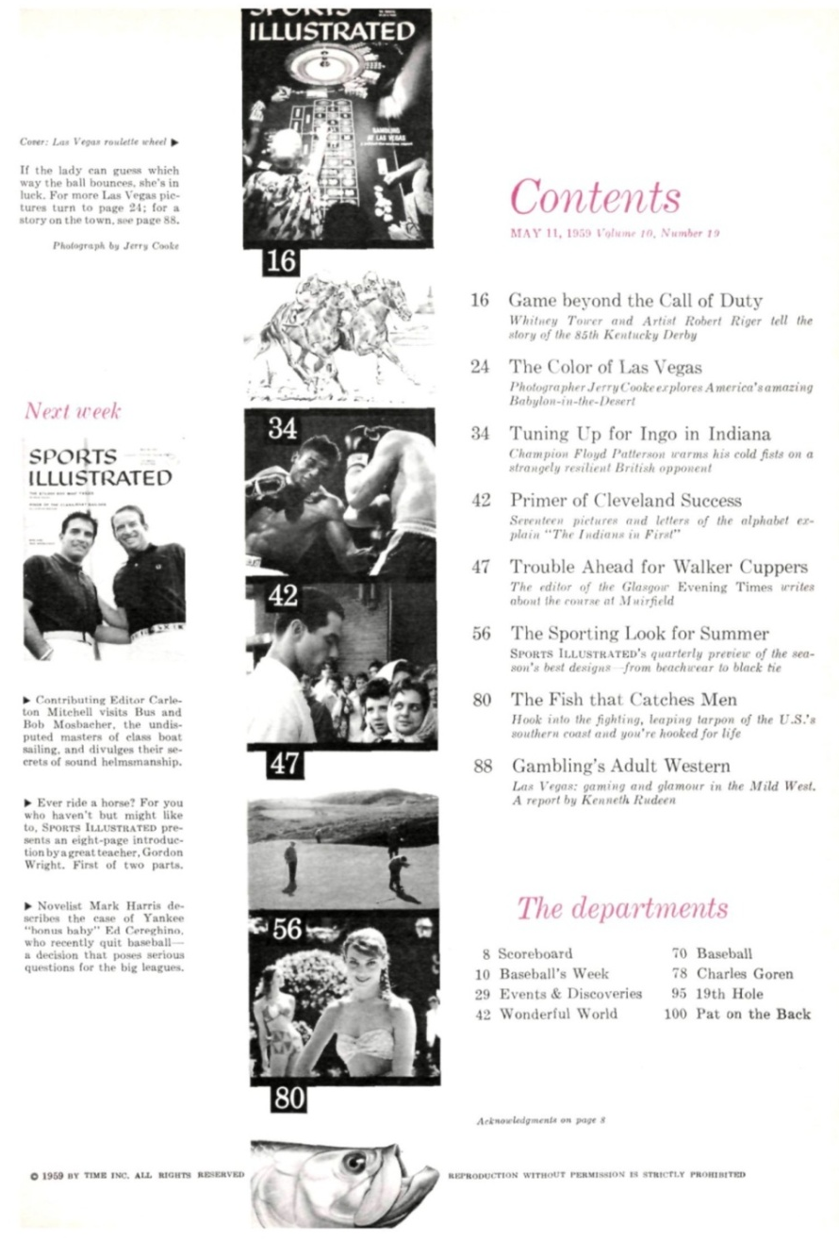
William Sinnott, acting chairman of the Gaming Control Board stated: "We diligently scrutinize each individual who comes in here for a license. He is further scrutinized publicly—with the press there—when his license comes up for both preliminary and final approval. Once he gets his license, there is a constant audit and investigative program going on."
​
"Actually, the gaming setup operates in a goldfish bowl. It isn't anywhere near as mysterious as people think. Sure, there are constant rumors of hoods, and when there are we move quickly under the breadth of the law to run these rumors down. Invariably, there is absolutely no proof." This statement is not true, nor did the Gaming Control Board control the gangsters despite public appearance.

Slide 36
1960s

Slide 37
"Paris Come-on in Vegas." Life 48 (June 6, 1960): 51-57.

Slide 38
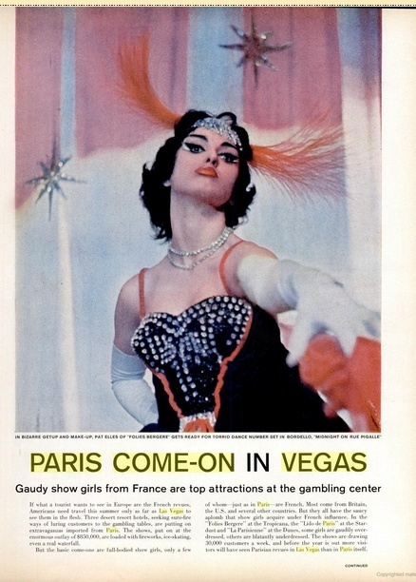
It is when the critics of culture turn their eyes upon Las Vegas that the importance of the city to American mythology is most apparent. Reviewing the shows on the Strip provides many opportunities for critical commentary on the shows themselves and on the city . Life had a tradition of titillation under the guise of amused detachment where Las Vegas is concerned, best expressed in a 1960 pictorial entitled "Paris Come-On in Vegas." Even the title could be a sexual pun, but the article is ostensibly about the craze for French-themed shows such as the "Folies Bergere" at the Tropicana.

Slide 39
"French Dressing," Saturday Evening Post, 1963.

Slide 40
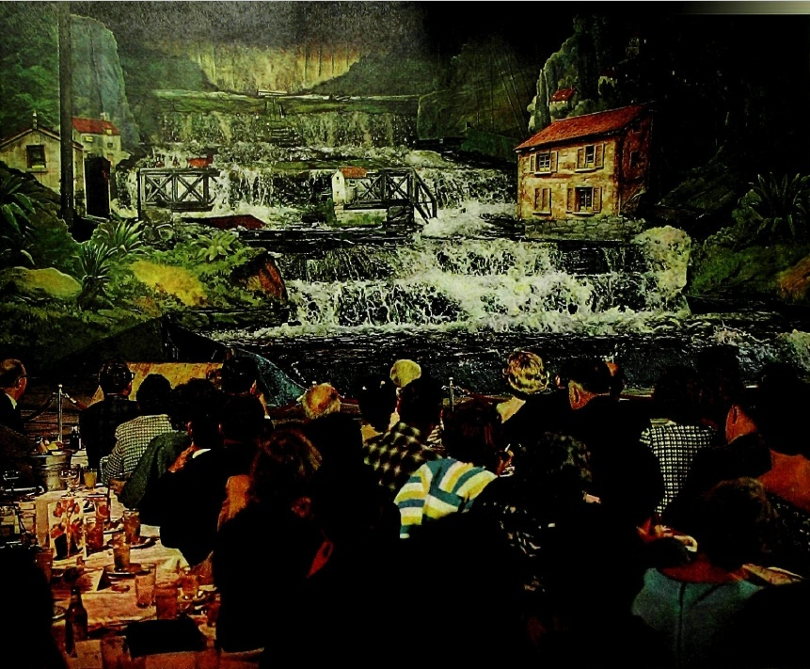
Likewise, in 1963 the Saturday Evening Post features an article on the "Lido de Paris" show entitled "French Dressing," in which it is alleged that "the real star of the show is the stage itself" (24), with its various spectacular moving parts.
Tense audience ignores drinks to watch water pour through gap in dam. The scene is based upon a 1959 disaster which wiped out a French town.

Slide 41
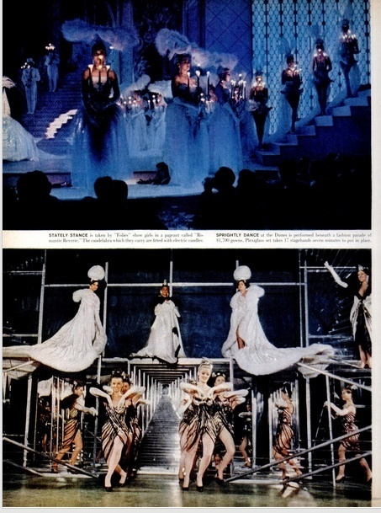
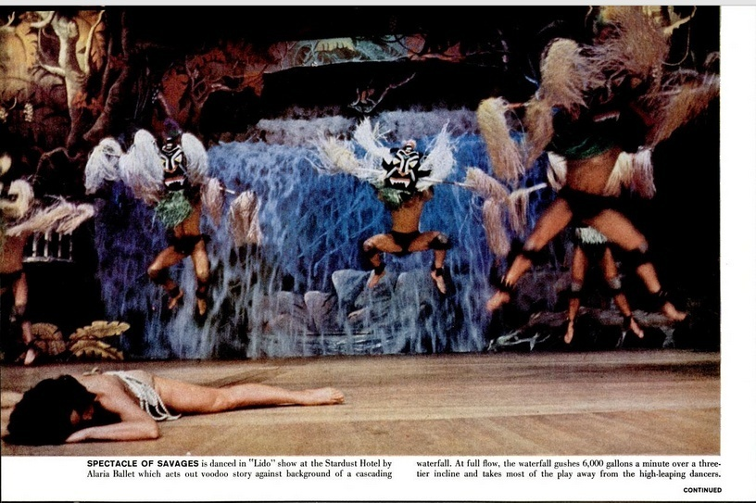
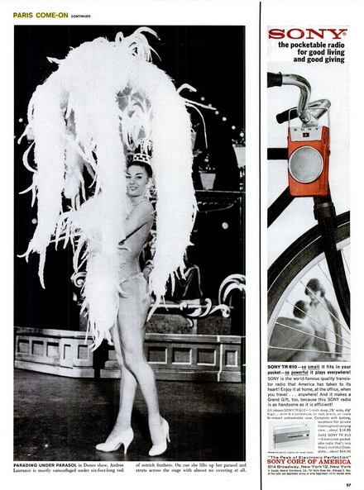
The text plays on the idea that "before the year is out more visitors will have seen Parisian revues in Las Vegas than in Paris itself" (51). The photographs are of provocatively posed showgirls, capped off with a revealing picture of a showgirl wearing only shoes, a spangled G-string, and a huge feathered headdress. The caption further escalates the sexual tension by informing the reader that "on cue she lifts up her parasol and struts across the stage with almost no covering at all" (57).​

Slide 42
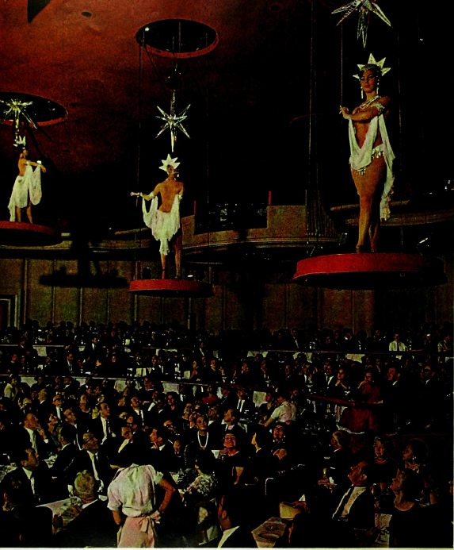
However, immediately opposite is a full-page photograph of three nearly naked girls suspended over the heads of the audience, somewhat lessening the impact of the statement about the stage.
Capacity crowd of neck-craning customers studies hanging garden of statuesque girls. The chorines, lowered from the ceiling, balance precariously during opening number.

Slide 43
The author of the article writes:​
​
"Las Vegas is a glittering mirage, and illusions seldom survive the dawn. But one of the most resplendent illusions of all. the Lido de Paris revue, seems destined to join the durable slot machines and dice tables as a permanent fixture. In a luxury oasis where such top performers as Eddie Fisher, Frank Sinatra and Dinah Shore are common decorations on cabaret programs, the Lido revue at the Stardust hotel ranks as top drawer. Since its debut in 1958. three million people have flocked to see it, and the nightly queue of customers continues to snake out into the adjoining Casino. Enthusiasts scattered as far as New York have placed standing orders for opening-night reservations of each new production. An adaptation of the famous show at the Lido nightclub in Paris—which has been running since 1929—the Las Vegas version is a brassy jumble of European variety acts and dazzling production numbers, touched with the bezazz of Ziegfeld and P.T Barnum.​
​
But the real star of the Lido is the stage itself, which is bigger than a basketball court. It unfolds a series of eye-popping effects—a twirling ice skater rising out of its center, a row of fountains sprouting mysteriously behind the dancers and entire sets adorned with ornately costumed girls elevate above stage level. Other girls perch overhead like chandeliers. At the end, the curtain showers sparks from magnesium fireworks. Behind the scenes nine wardrobe women and a crew of 16 men keep the show moving smoothly. Overlooking the stage, technicians in glassed-in booth—which looks like an airport control tower—blend lights and sounds to split-second cues.​"
​
The fantasy they create keeps packing the house. The fame of the Las Vegas version of the Lido has spread so far, in fact, that one show official says, "We've actually stirred up so much interest that we've helped to increase the business of the original Lido in Paris."

Slide 44
The stage itself—constructed especially for the revue—is as intricate as a Chinese puzzle. "Most shows are built around a stage." explains company manager Bill De Angelis, "but this is a case of building a stage around a show." Six hydraulic elevators are controlled by individual push buttons. So is a large hinged section of the floor that ascends with a mirror attached so that the audience sees the reflection of a swimming pool below.​
​
There are machines to produce lightning, thunder, water, fire, snow and wind. Closed-circuit television allows the backstage staff to follow the progress of the performance—the orchestra drummer, for example, is so far away he must take his cues from the TV screen. The most fascinating gimcrack is a system of water pumps that creates the piece de résistance of the current production. The pumps are used in a scene which depicts a river valley below a high dam. A storm breaks and rain falls on the stage. Suddenly the dam bursts, and 12.000 gallons of water pour through the gap. across the stage and straight toward the audience {above). At the last moment the water drains off" in a channel behind the footlights, while the front-row patrons fight the urge to dash for the exits. ​
​
The scene is so spectacular that it has led to a major concern: The management, now planning a new revue edition for this fall, is wondering what it can do for an encore.

Slide 45
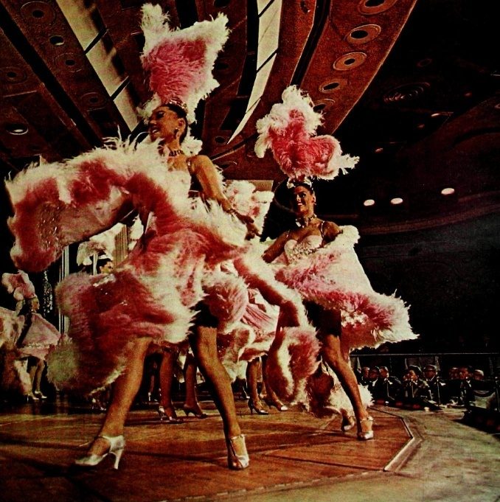
A fresh corps of showgirls have been imported and trained in the methods of speeding through as many as eight elaborate costume changes per show. They also are coached in the stratagems of flashing contented smiles as they stroll nonchalantly on four-inch heels two feet from the edge of a twelve-foot pit near the middle of the stage.​
​
A harem number features "Les Bluebell Girls" in a flurry of pink capes and ostrich feathers. The biggest item of the stage manager's budget is a $1,200 monthly bill for repair of girls' shoes.

Slide 46
"What's That Up There? Shut Up and Deal." Life 65 (Nov. 29,1968): 49-52+.

Slide 47
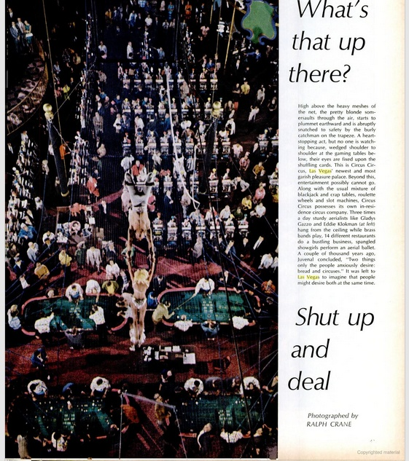
Life joyfully welcomes the opening of the Circus Circus in 1968 with a five-page pictorial which juxtaposes pictures of the acrobatics of the circus performers above the casino floor with captions which inform the reader that the gamblers "lay bets on whether or not [the high diver] will make it [65 feet into a 5x9-foot patch of foam rubber]" (50-51).

Slide 48
Las Vegas (What? Las Vegas (Can't hear you! Too noisy) Las Vegas!!!!" Esquire 61 (February 1964): 97-103.

Slide 49
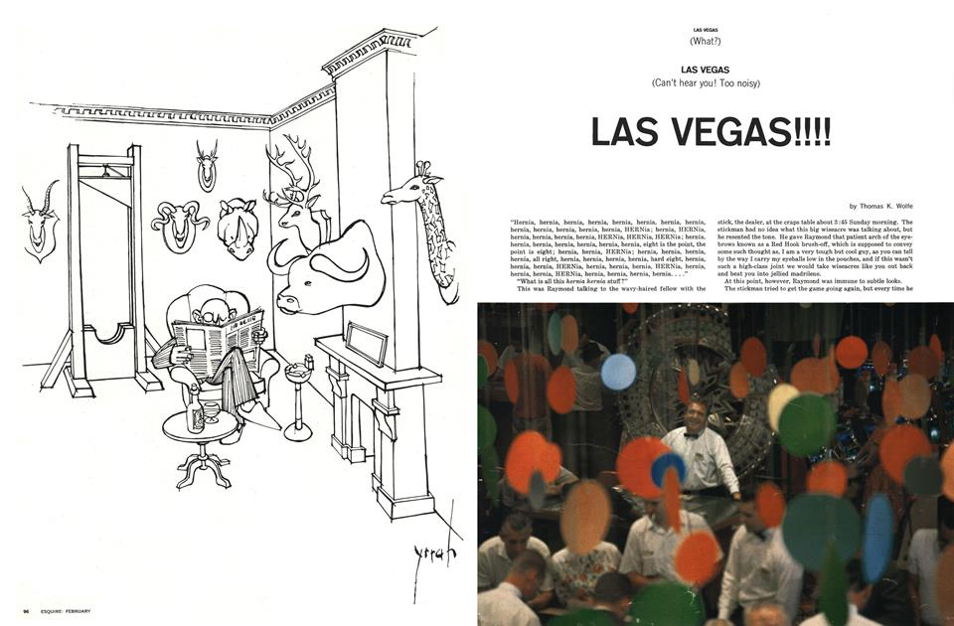
Tom Wolfe is one of the best-known commentators on Las Vegas in the 1960s. His classic article, "Las Vegas (What?) Las Vegas (Can't hear you! Too noisy) Las Vegas!!!" was later included in his collection The Kandy-Kolored Tangerine-Flake Stream Line Baby and in the 1995 anthology Literary Las Vegas.

Slide 50
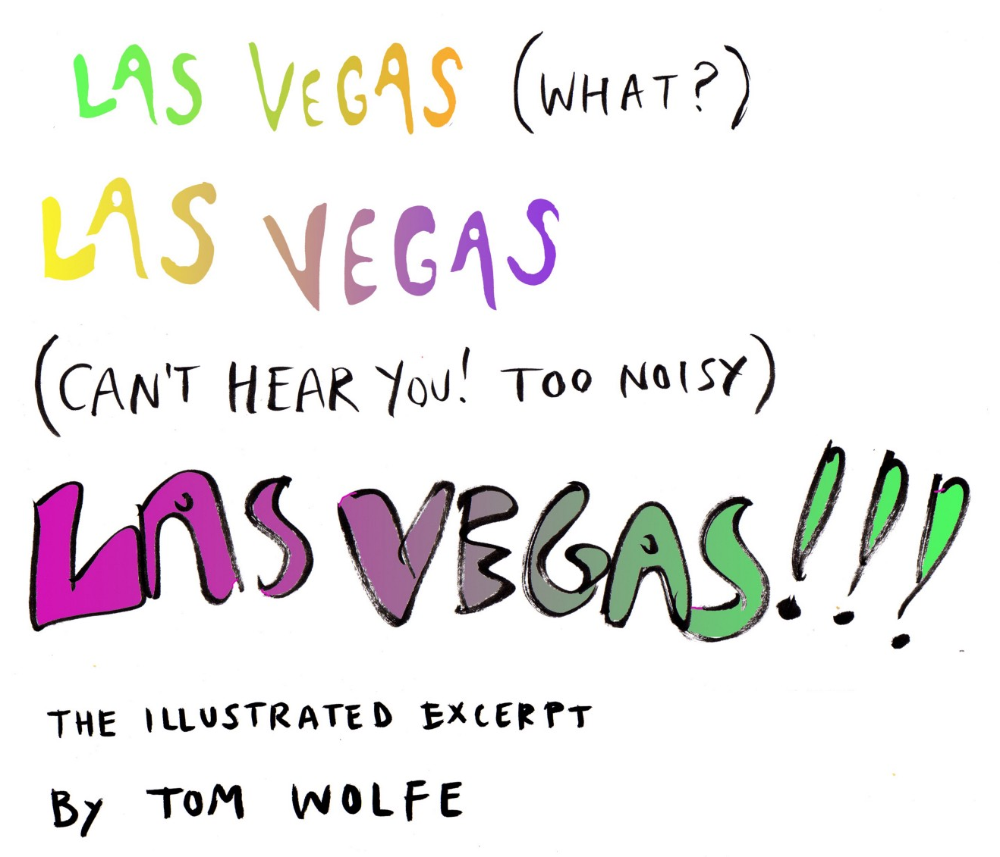
Wolfe applies his exuberant journalistic style to the city, resulting in one of the funniest discussions extant. His musings on the various types of gamblers and casino managers, the incessant noise (both aural and visual) prevalent in town, the costumed waitresses ("a stimulus that is both visual and sexual—the Las Vegas buttocks decolletage"), and the democratic nature of the place produce some of the very best writing about Las Vegas in the 1960s.

Slide 51
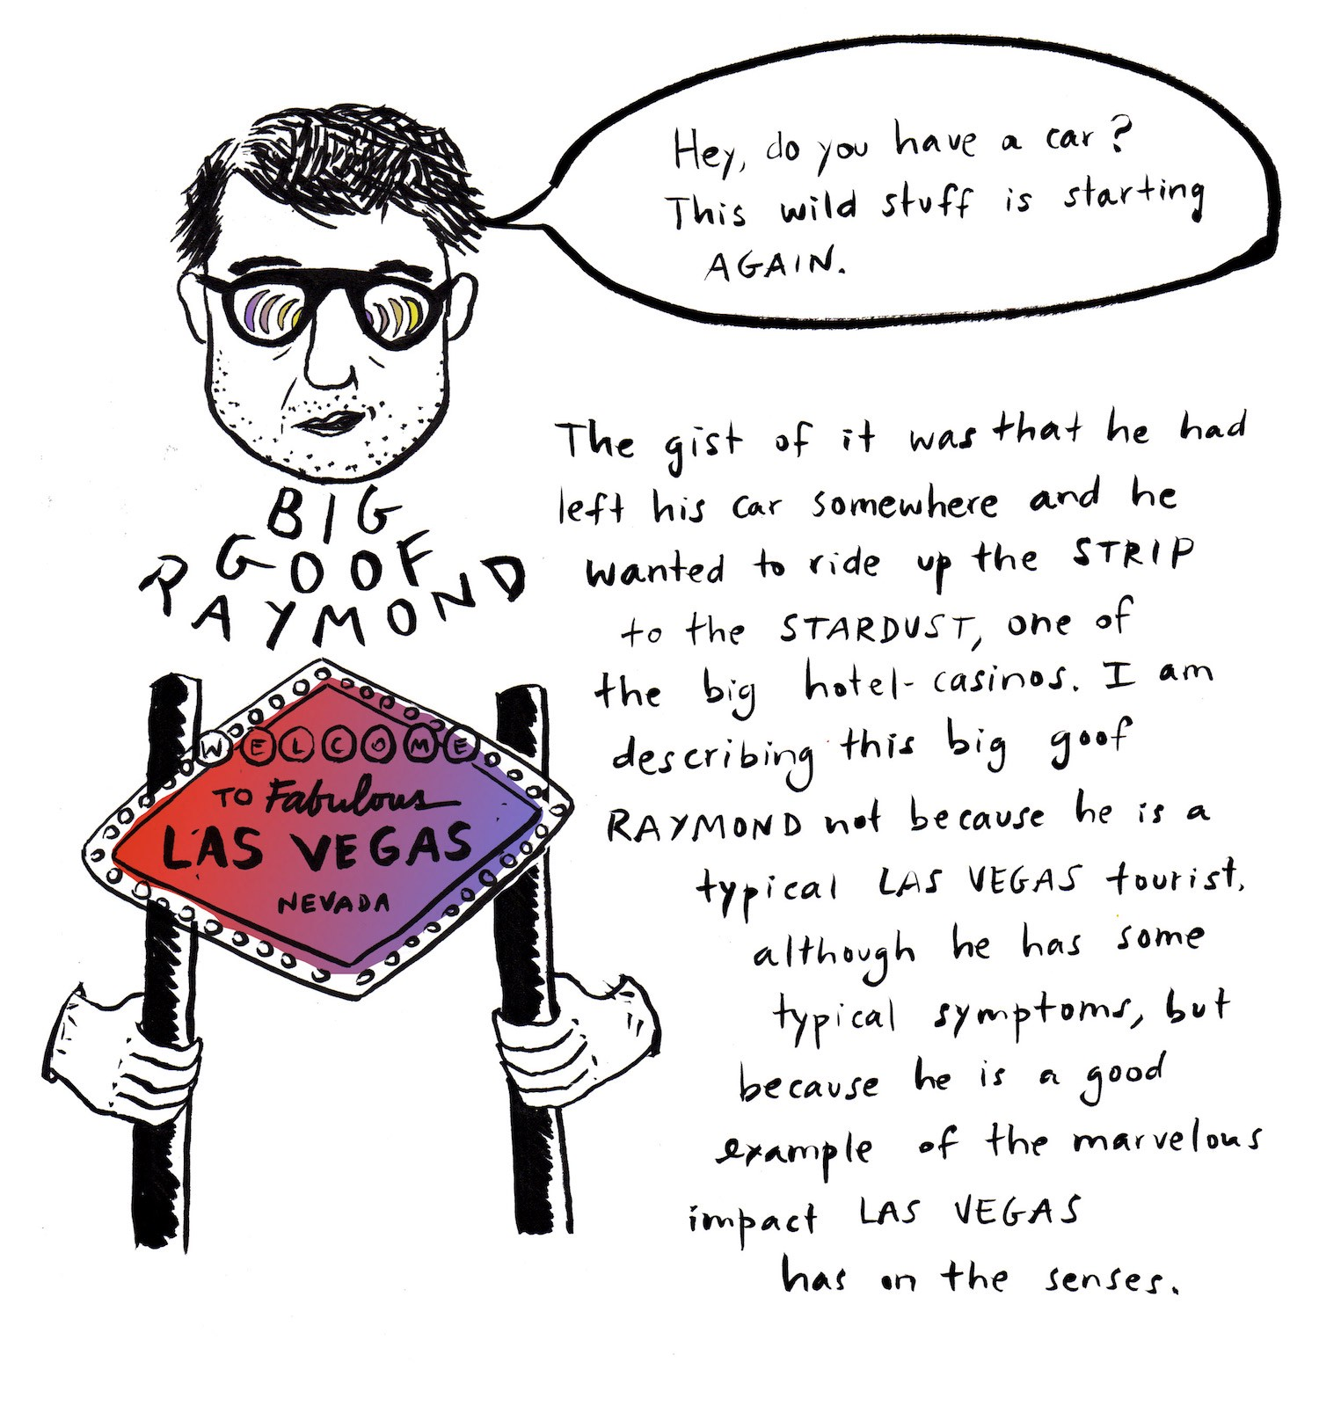
Wolfe's main point is that "Las Vegas has become, just as Bugsy Siegel dreamed, the American Monte Carlo—without any of the inevitable upper-class baggage of the Riviera casinos."
​
"At Monte Carlo there are still Wrong Forks, Deficient Accents, Poor Tailoring, Gauche Displays, Nouveau Richness, Cultural Aridity—concepts unknown in Las Vegas" (13). Part of Wolfe's stylistic mastery lies in his use of the ironic capitalization which transforms these attributes; Las Vegas, of course, is home to all of these, but it is the cultural snobbery against them which is absent.

Slide 52
“Vacation in Las Vegas." Ebony 20 no.8 (June 1965): 180+.

Slide 53
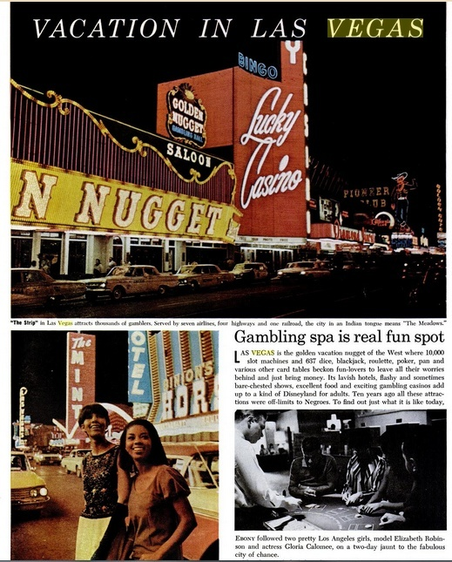
A 1965 Ebony article ("Vacation in Las Vegas") is one of the few to even mention a black perspective; the text contends that "Despite Las Vegas' once-shabby history of racial prejudice, there seems to be little or no hold over in the current atmosphere."

Slide 54
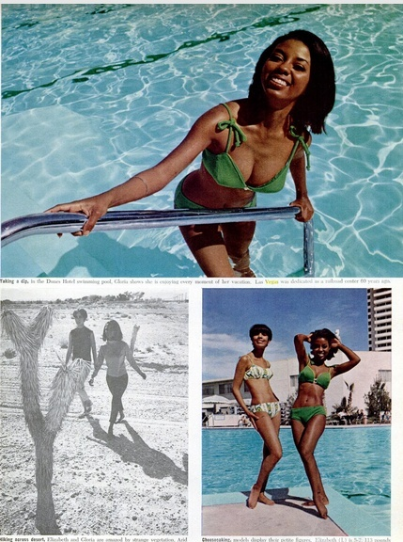
"The cluster of posh hostelries along 'The Strip' now accept [black] guests and they are no longer barred in Strip or downtown n casinos" (180-82).

Slide 55
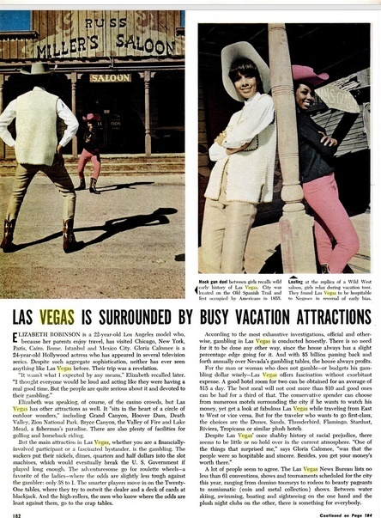
The accompanying photographs feature two black models as they gamble, sightsee, sunbathe, and go to shows, and the overall effect is entirely positive.

Slide 56
Despite the industry's accolades and its coverage of the United States Life by the end of the 1960s continued to lose circulation and finally ceased publication. Look had the same fate. It ceased publication with its issue of October 19, 1971, the victim of a $5 million loss in revenues in 1970, (with television cutting deeply into its advertising revenues), a slack economy, and rising postal rates. So did The Saturday Evening Post close. Its February 8, 1969, issue was the magazine's last. Otto Friedrich, the magazine's last managing editor, blamed the death of The Post on a corporate management was unimaginative and incompetent. Friedrich acknowledges that The Post faced challenges while the tastes of American readers changed over the course of the 1960s, but he insisted that the magazine maintained a standard of good quality and was appreciated by readers. The era of these pictorial magazines was over to be replaced by a wide assortment of magazines that were less concerned with newsworthy articles and more specific in their coverage of travel, hair, country life, food, etc.

Slide 57
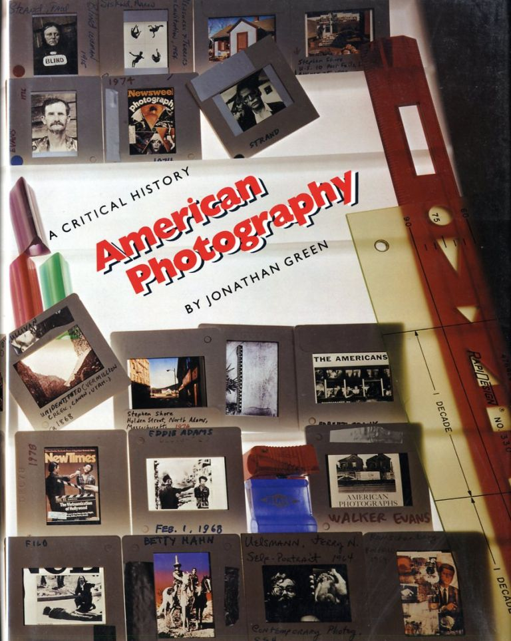
The problem with Baldwin’s analysis of photo-essays in magazines is that his principal interest is in the texts since his dissertation is in the field English literature.​
​
In "Photography as Popular Culture" (Journal of the University Film Association, 30, no. 4: 15-20) , Jonathan Green considers the photo-essay "as a device developed to guarantee the promotion of the proper image... The photo-essay represented the latest step in the journalistic and technological trend toward conveying and popularizing the news; of telling the story at a glance. The photographs invited viewers' attention and convinced them of the story's accuracy… Yet such a close relationship between words and images is tenuous at best. Headings and captions tend by their very nature to be simplistic and redundant. They communicate not so much by describing the picture as by identifying and confirming what the reader already knows… or what the editor thought they should know." ​
​
Green’s viewpoint is that he photo essay reinforced the popular notion of photography as simplistic, immediate, dramatic and didactic, relegating photography's use to either the sensational or the pictorial. In the hands of the popular photographer, photography's virtues are precisely its failures. In trying to come to grips with that world which photography could really touch, the photographic endeavor is reduced to a series of stirring and rhetorical moments. Realism is seen only as a repetition of those things already seen and known. The subjects are not things in themselves. Rather they are exaggerated and moralized political viewpoints.

Slide 58
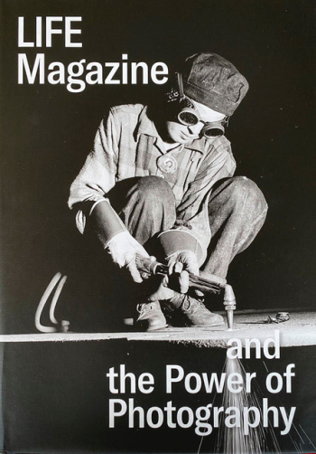
Green diminishes the value of the photo-essay and the contribution of the photographer. Others disagree with Green’s assessment. In LIFE Magazine and the Power of Photography the contributors emphasize that the vast majority of the photographs printed and consumed in the United States appeared on the pages of illustrated magazines. The photography featured in Life magazine fundamentally shaped the modern idea of photography in the United States.
Katherine A. Bussard, Kristen Gresh, and 11 other editors and contributors, LIFE Magazine and the Power of Photography (Princeton University Art Museum, 2020).

Slide 59
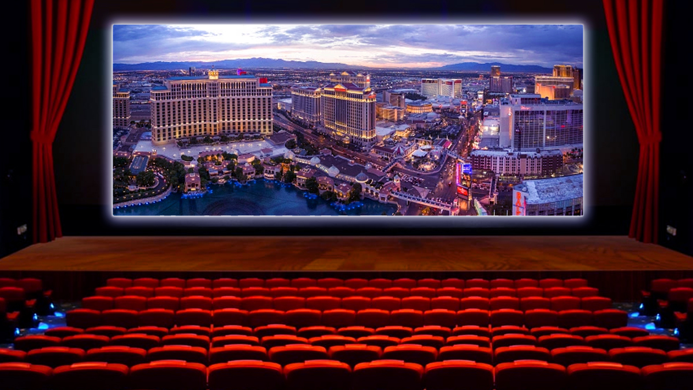
This next section is based on Baldwin’s appendix on films in his dissertation.​
​
He writes: "Film has been an important medium when it comes to depicting the city in American popular culture. What film provides is a visual depiction of Las Vegas which serves as another type of commentary on the city. Of the one hundred or so films which deal with Las Vegas, only a few are of major importance in expressing aspects of the city through the visual medium; many films use the city merely as a backdrop, as Las Vegas provides a 'set' unlike any other place and thus provides a great deal of color, activity, and interest for the filmmaker to capture. ​
​
Each decade brings more films set—either in whole or in part—in Las Vegas, or which involve the city in some other important way. Like New York and Los Angeles, Las Vegas is a popular urban setting for films; unlike most films set in those East and West Coast capitals, though, Las Vegas films rarely depict actual residents or long-time inhabitants. The city is usually treated as a tourist destination so that people have to go out of their way in order to get there, and this aspect of Las Vegas as either a destination or a way station makes the city particularly suitable for whatever kind of symbolic reflection of American society is required for the film."

Slide 60
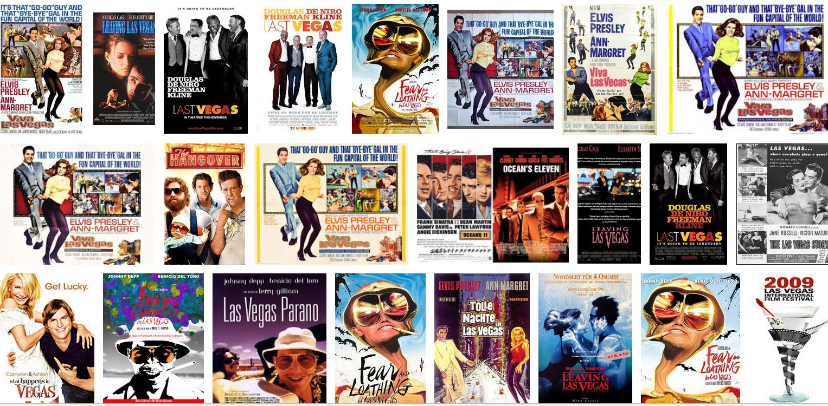
Baldwin examines the depiction of Las Vegas in films according to different categories, depending on how the city is used in each work.​
​
These themes include:​
The apocalyptic destruction of the city as punishment for its transgressions ​
The satirical exposure of Las Vegas (and American) values ​
The temptation of big money; power and organized crime​
The desire to escape from reality ​
The use of gambling as the effect of greed on the human spirit; a metaphor for chance; to enhance a sense of self ​
The portrayal of Las Vegas as the city most representative of the American dream

Slide 61
LAS VEGAS AND POPULAR FILMS
Notes:
Popular Films

Slide 62
The apocalyptic destruction of the city
as punishment for its transgressions

Slide 63
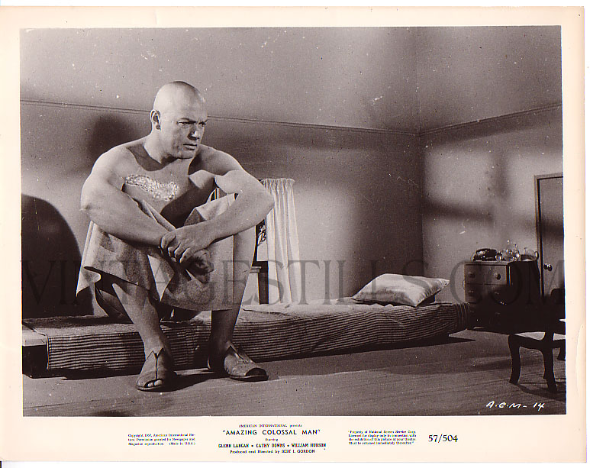
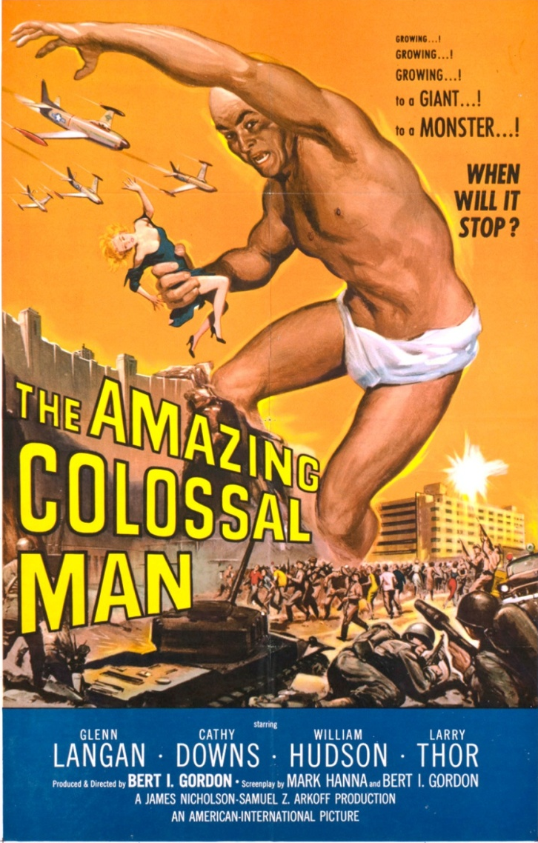
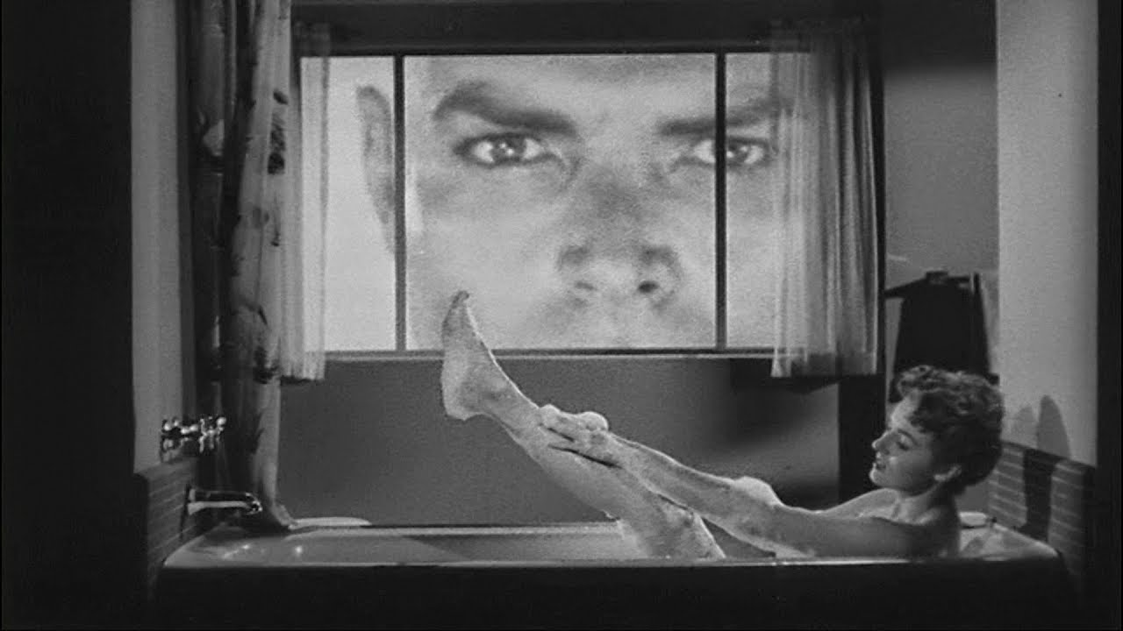
The Amazing Colossal Man, 1957.
In The Amazing Colossal Man (1957) a military officer survives a nuclear blast, only to begin to uncontrollably grow into an increasingly unstable giant. It is not the obvious theme but it is significant: Las Vegas is turning into another Disneyland. The instant gratification on which the city was built reduces all of us to big children, demanding that our every need be taken care of regardless of the destruction that this may cause to us or to our surroundings. The satire exists in the mind of the observer and may not be a result of the filmmakers' intentions.

Slide 64
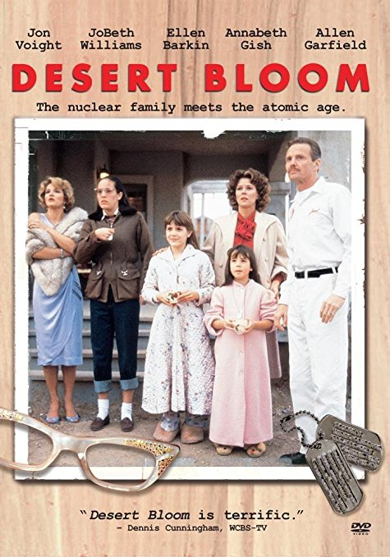
Desert Bloom, 1986.
In the decade of the 1980s, the development and testing of atomic weapons was exploited by Hollywood in a different way. Desert Bloom (1986) used the bomb as a dramatic device to illustrate tensions within a family. Set in 1950, against the mystery and suspense surrounding early nuclear testing in Nevada, the film was sponsored by the Sundance Institute, an organization founded by Robert Redford to encourage young film directors. The delicate relationship between Jack, his wife, and his stepdaughter Rose is unbalanced by the arrival of his sister-in-law, the glamorous Starr.

Slide 65
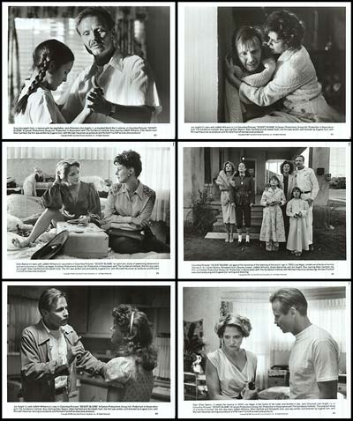
Pressure builds as Jack lusts after Starr and unsuccessfully tries to contain his own volatility. Rose, an adolescent on the verge of self-discovery, idolizes her dazzling aunt. When Rose discovers her stepfather's attraction to Starr, the explosion is sparked, given dramatic emphasis by the atomic blast. Vincent Canby of the New York Times wrote, "Desert Bloom is the sort of movie in which the characters attain a new plateau of understanding just as that first, shimmering mushroom cloud is rising beyond the horizon, lighted by the early morning sun. As the reunited family watches the mushroom cloud, the viewer wonders if all will go on as before, or if Pandora's Box has indeed been opened."
Desert Bloom, 1986.

Slide 66
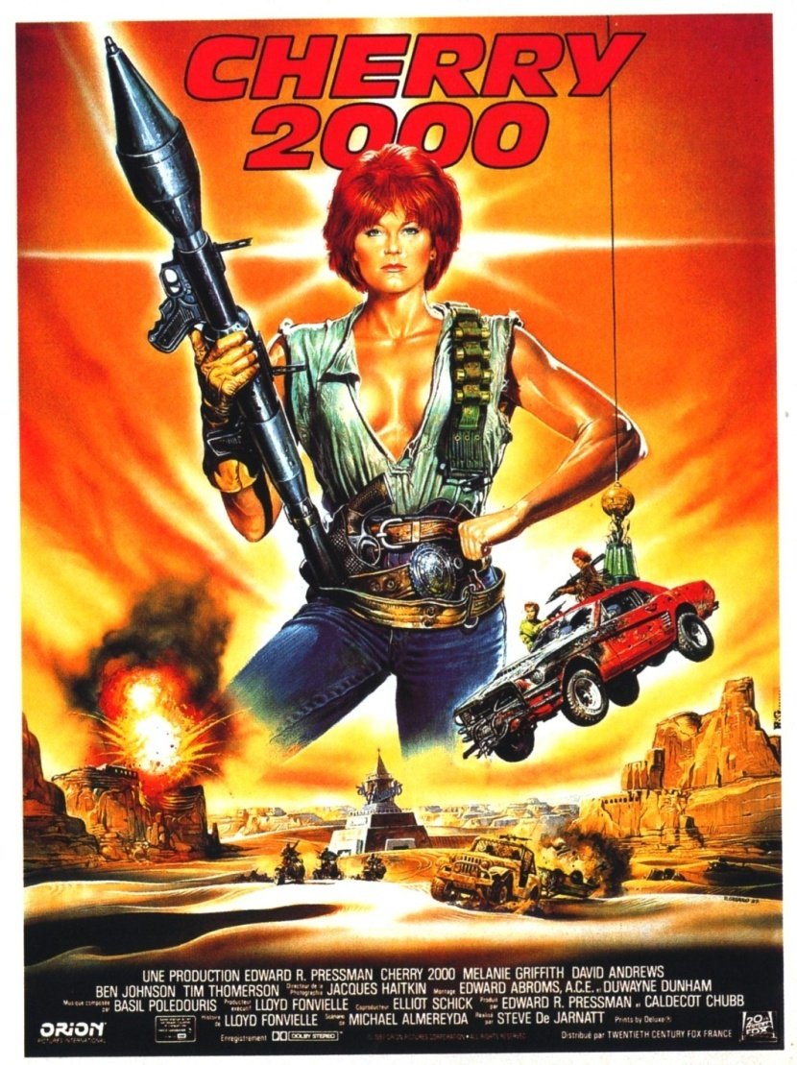
Cherry 2000, 1988.
With the revival of concern about nuclear testing and nuclear war in the 1980s, a number of films have appeared that envision a post-nuclear-holocaust world. One of these, Cherry 2000 (1988), was filmed in various locations around southern Nevada. It was never released nationally and played only exceptionally limited runs in selected markets. Still, it contained intriguing references to Las Vegas. In this futuristic world, relations between men and women are so strained as to require elaborate contracts as preliminaries for the slightest of social contacts. It is much easier simply to purchase a robot.

Slide 67
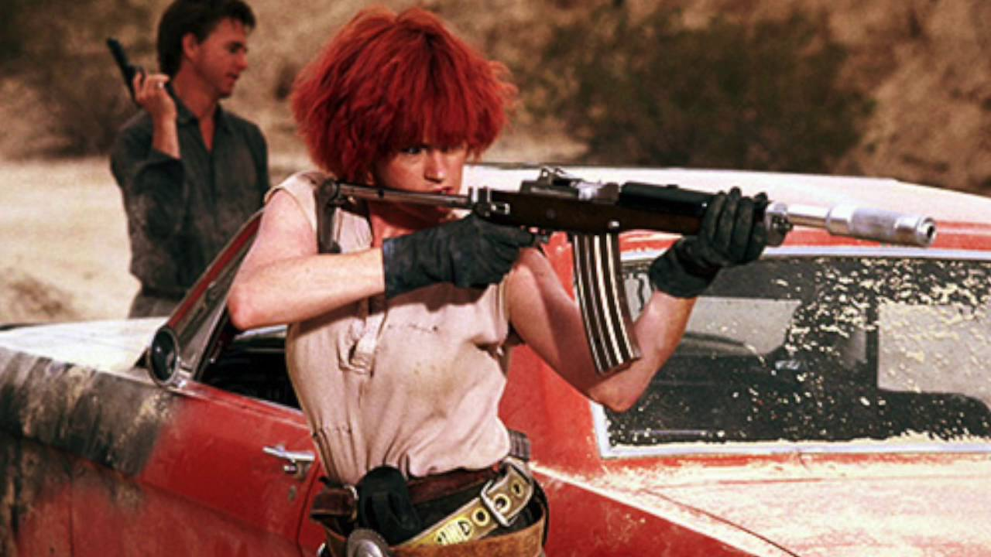
With the revival of concern about nuclear testing and nuclear war in the 1980s, a number of films have appeared that envision a post-nuclear-holocaust world. One of these, Cherry 2000 (1988), was filmed in various locations around southern Nevada. It was never released nationally and played only exceptionally limited runs in selected markets. Still, it contained intriguing references to Las Vegas. In this futuristic world, relations between men and women are so strained as to require elaborate contracts as preliminaries for the slightest of social contacts. It is much easier simply to purchase a robot. Unfortunately for our hero, Sam Treadwell, his android suffers a short circuit. While he has the computer chip containing the memory, the only replacement bodies are in the robot graveyard, located in what was once Las Vegas, now Sector 7. Seeking the best tracker available to lead him through this dangerous wilderness, he hires E. Johnson (Melanie Griffith), a very human female, with predictable results. What is interesting about this film is the scene of a devastated Las Vegas, now overrun by desert, with only a few neon signs remaining. While a low-budget feature such as this generally does not have any deep message, perhaps one might comment on the appropriateness of Las Vegas as the storage depot for glamorous and sexy yet artificial women.
Cherry 2000, 1988.

Slide 68
War Games. Dir. John Badham. MGM, 1983.
The impulse to destroy Las Vegas is one of the responses that filmmakers have had to this desert city. Las Vegas holds an attraction for some artists as a place where destruction on a Biblical or apocalyptic scale can take place. At the beginning of the film War Games the teenagers played by Ally Sheedy and Matthew Broderick are trying to think of a city which would be a suitable target to begin their game of global thermonuclear war. "Who should we nuke first?" asks Broderick, and it takes only a second before Sheedy gleefully answers, "How about Las Vegas?" "Las Vegas? Great," replies Broderick, as they both smile and laugh.

Slide 69
War Games. Dir. John Badham. MGM, 1983.
The implication, of course, is that Las Vegas is a perfect place to attack with nuclear bombs, and that anyone—even a teenager—would recognize that it is only fitting this should be so. What is interesting in this brief exchange is the unspoken feeling, which the audience is expected to recognize and to share with the characters, that Las Vegas should be wiped off the face of the earth.​

Slide 70
Mars Attacks. Dir. Tim Burton. Warner Bros., 1996.
War Games is not the only film in which the annihilation of Las Vegas is envisioned. In Tim Burton's Mars Attacks (1996), the city plays a prominent role in the action when the Martians land in nearby Pahrum and go on to destroy everything in their path.

Slide 71
The Landmark hotel-casino, here called the Galaxy, is used for its implosion at the end of the film, with actual footage from the demolition intercut with scenes of the actors. This scene points to another interesting aspect of Las Vegas on film: just as the demolitions of hotels such as the Dunes, Hacienda, and Sands are staged as real-life spectacles for tourists on the Strip, so are they used in films as exciting tableaux of destruction.
Mars Attacks. Dir. Tim Burton. Warner Bros., 1996.

Slide 72
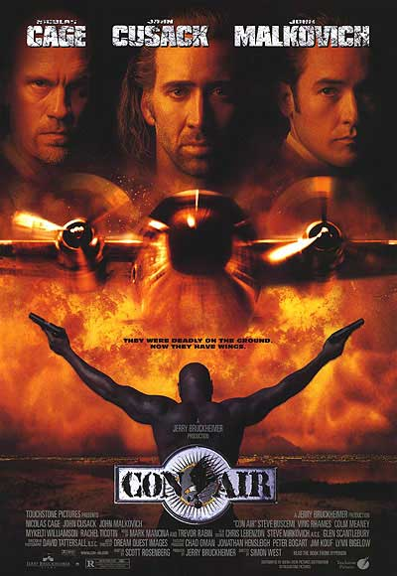
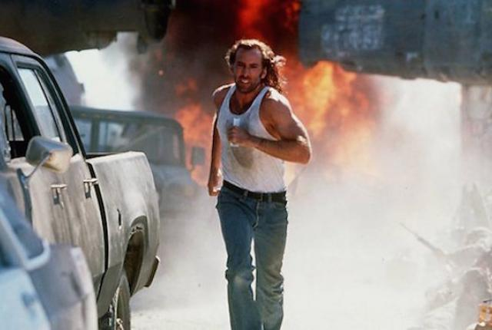
Con Air, 1997.
The 1997 film Con Air uses a similar technique when it stages a plane crash into the lobby of the about-to-be-imploded Sands. In a way, these films preserve and commemorate a past Las Vegas which exists otherwise only in peoples' memories. Burton dearly enjoys the destruction of Las Vegas, showing a number of scenes of the entire Strip going up in flames, and cranking up the kitsch factor by having Tom Jones sing "It's Not Unusual" onscreen while the aliens attack his audience.

Slide 73
As inhabitants of this sinkhole, Jack Nicholson, as Art, the Galaxy's owner, and Annette Bening, as his wife, personify the cultural and intellectual aridity of Las Vegas. Nicholson (here looking and sounding remarkably like the professional wrestler Macho Man Randy Savage) captures the extreme tackiness and white-trash qualities of the city, with Art's house a masterpiece of bad taste. Annette Bening portrays a New Age airhead who welcomes the Martians and rails against people like her husband whose greed, she says, is "destroying the earth." There is a sense, then, that Las Vegas is getting what it deserves when it is attacked.
Con Air, 1997.

Slide 74
The satirical exposure of Las Vegas (and American) values

Slide 75
King Ralph. Dir. David S. Ward. Universal, 1991.
Besides being blown up in various ways. Las Vegas has also come under satirical attack in some films. The satire usually takes the form of treating Las Vegas as the quintessential American city , the one which, more than any other, exemplifies the values and characteristics of our society. This form of representation is followed in King Ralph, which depends for its humor on the contrast between boorish American behavior and proper English manners.

Slide 76
When the entire royal family of England dies in a freak accident, the closest heir to the throne is found to be an American lounge singer in, of course, Las Vegas. Our first look at this unknowing heir consists​ of John Goodman in an electric blue tuxedo singing 'Tiny Bubbles’ and watching a football game on television, all of this intended to emphasize the culture shock in store for both Ralph and for the English.​
King Ralph. Dir. David S. Ward. Universal, 1991.

Slide 77
Beavis and Butt-Head Do America. Dir. Mike Judge. Universal, 1996.
Bankrupt American culture is also satirized in Beavis and Butt-Head Do America (1996). Here, the uncouth cartoon protagonists encounter a busload of senior citizens on their way to Vegas, a context which affords opportunities for multileveled humor. First, on the sophomoric level, old people are depicted as out-of-touch and physically decrepit, and second, on a slightly more advanced level, Las Vegas as a favorite destination for the elderly is cleverly lampooned. These two scenarios are entwined when Beavis, mishearing the old woman seated next to him on the bus when she mentions playing the slot machines, remarks that he too is "looking forward to doing some sluts in Vegas."

Slide 78
The woman assures him that there are plenty to go around. Once the boys get to town, they enjoy the visceral pleasures which Vegas offers everyone, but they express their pleasure in their own inimitable ways. When confronted with an Egyptian-type figurehead on a reed boat decorating a Luxor-style casino, the boys gape in amazement at the comically enormous breasts on the statue, and when the obligatory dance sequence occurs, it is in a cheesy lounge dominated by a seventies-type band playing ‘Love Rollercoaster.’ The satire here is actually rather sophisticated, as these Las Vegas clichés are only slightly more exaggerated in the cartoon than they are in real life.​
Beavis and Butt-Head Do America. Dir. Mike Judge. Universal, 1996.

Slide 79
Honey, I Blew Up the Kid. Dir. Randal Kleiser. Buena Vista, 1992.
Another potentially (but probably unintentionally) satirical film is Honey, I Blew Up the Kid (1992), in which a toddler becomes gigantic when he is exposed to the energy fields surrounding the millions of lights in the city. As the child stomps down Fremont Street, the visual cue points us to films such as Godzilla and The Amazing Colossal Man.

Slide 80
The temptation of big money

Slide 81
Ocean's Eleven. Dir. Lewis Milestone. Warner Bros., 1960.
If Las Vegas is not being physically or satirically attacked in the movies, it is often being plundered. With all of that money circulating, Las Vegas is in many ways the perfect location for a crime movie, especially in the sub-genre of the heist film. One of the best of these, indeed one of the all-time greatest Las Vegas films, is Ocean's Eleven (1960). In this film, the Rat Pack gets together as a former Army unit set on knocking out the power and robbing five Strip casinos on New Year's Eve. The plot, though, is largely an excuse to showcase the style with which the performers carry it out. This style, including Sammy Davis Jr. as a singing garbage man, is incomparable, and the entire film is a good-spirited laugh, with the added bonus of seeing early 1960s Vegas in all of its swanky, retro glory.​

Slide 82
The plot, though, is largely an excuse to showcase the style with which the performers carry it out. This style, including Sammy Davis Jr. as a singing garbage man, is incomparable, and the entire film is a good-spirited laugh, with the added bonus of seeing early 1960s Vegas in all of its swanky, retro glory.
Ocean's Eleven. Dir. Lewis Milestone. Warner Bros., 1960.

Slide 83
They Came to Rob Las Vegas. Dir. Antonio Isasi. Warner Bros., 1968.
Another, less amusing heist film is They Came to Rob Las Vegas (1968) in which a gang of thieves attacks an armored car full of money and buries it out in the desert.

Slide 84
Casino. Dir. Martin Scorsese. Universal, 1995.
Martin Scorsese's Casino (1995) is, in its own way, a heist film, as it details the mob-run skimming operations of the 1970s. The brazen nature of the skimming, among other things, eventually led to the downfall of the mob's control of casinos. The film is a relatively accurate, if artistically bloated, depiction of these events, with heavy doses of 1970s style in its clothes, music, and overall design. ​

Slide 85
Diamonds Are Forever. Dir. Guy Hamilton. United Artists, 1971.
Finally, Diamonds are Forever brings James Bond to Las Vegas to investigate a diamond-smuggling ring; this film has plenty of location shots so Las Vegas in the 1970s can be seen to good effect, although the extension of the International Hotel (now the Hilton) is a little startling, looking like a futurist experiment.

Slide 86
What these heist films have in common is the audacity of the crimes they depict; as Las Vegas itself is an outrageous entity, so must any attempts to steal some of its luster be outrageous as well.
Diamonds Are Forever. Dir. Guy Hamilton. United Artists, 1971.

Slide 87
Power and organized crime

Slide 88
Guns, Girls, and Gangsters, 1958.
Power is also associated with Las Vegas in film in the guise of organized crime. Underworld figures have been connected with Las Vegas since the late 1930s, when a public-spirited purge of Los Angeles's Spring Street gambling dens prompted the operators to move to a more hospitable climate. Several films have exploited Las Vegas's association with mobsters. Most motion pictures involving the Mafia reflect the realities of the underworld by placing Las Vegas on the periphery, not at the center of power. In Guns, Girls, and Gangsters (1958) a group of assorted criminals in Las Vegas plans the robbery of an armored truck hauling casino money to the bank. ​

Slide 89
The Godfather, 1972.
Despite efforts by the state to eliminate underworld influence in the gaming industry, Las Vegas continues to be associated in the public mind with organized crime. Advertising campaigns designed to attract the middle-class tourist have met with great success, and conventions and sports events have lent more respectability, but Las Vegas will never be, in the movies or elsewhere, the All-American city. Perhaps the thought of possibly rubbing elbows with dangerous criminals is an attraction for visitors, those who would use their vacations to seek the unusual or to encounter, at a safe distance, a little danger.

Slide 90
Frankly, there is little excitement in the thought of casinos being tightly regulated and scrupulously honest, but a shiver runs down the spine and a sense of alluring corruption emerges at the idea that casinos are run by notorious underworld figures. The most obvious example of this is Mario Puzo's The Godfather (1972), in which Michael Corleone decides that Las Vegas is "where the future is for the Family... Some friends of ours own a good percentage of the hotel and casino so that it will be our foundation. Moe Greene will sell us his interest so that it can be wholly owned by friends of the Family I'll make him an offer he can't refuse‘." This Mafia family thus enters Las Vegas by using a combination of entrepreneurial vision and good old-fashioned bloody threats and intimidation.
The Godfather, 1972.

Slide 91
Oh God, You Devil, 1984.
According to Hollywood, however, the Mafia bosses are not the only powerful forces that inhabit Las Vegas. Even God and Satan, both looking exactly like George Burns, come to gamble. In the 1984 film Oh God, You Devil, Caesar's Palace was host to the two adversaries as they played poker, with the stakes a human soul.

Slide 92
Oh God, You Devil, 1984.
When asked in the film, "Why Las Vegas?" the Lord answered, "1 have my reasons, don't question them." And Satan glibly announced that he spent a few weeks in Vegas every year.

Slide 93
The desire to escape from reality

Slide 94
Meet Me in Las Vegas. Dir. Roy Rowland. MGM, 1956.
The city's position as one of the most popular tourist destinations in the world makes it an ideal setting to represent an escape from the reality of everyday life. Films in this genre range in tone from irrepressibly upbeat to incredibly depressing. Examples of the former include the musicals Meet Me in Las Vegas (1956) and Viva Las Vegas (2964). ​

Slide 95
Meet Me in Las Vegas (1956) is a romantic musical comedy featuring cowboy Dan Dailey and dancer Cyd Charisse, who can win jackpots if they simply hold each other's hands while betting. On gorgeous sets, filmed in blazing Technicolor, after much singing and dancing, the two fall in love.
Meet Me in Las Vegas. Dir. Roy Rowland. MGM, 1956.

Slide 96
Viva Las Vegas. Dir. George Sidney. MGM, 1964.
Similarly, in Viva Las Vegas (1964), Elvis Presley plays a race car driver who falls in love with a dancer (Ann-Margret), and the film is one of the happiest and most entertaining looks at Las Vegas as a place largely exempt from the pressures of real life.

Slide 97
There is no illness here, and if money is lost it is only temporary; the whole place is drenched in bright colors and warmth.
Viva Las Vegas. Dir. George Sidney. MGM, 1964.

Slide 98
Elvis' enduring popularity in Vegas is a tribute to the bonds forged between the singer and the city in a seven-year run between 1969 and 1976, a period fondly remember as the "Vegas Years." It's a legacy that continues to this day. "He was the show in town—the one everyone wanted to go to because he was just really hot and was coming back with new music, said singer Terry Blackwood, a member of the Imperials who sang backup for Elvis." "Everyone wanted to see Elvis." Elvis first performed in Las Vegas in 1956 when he was just 21 years old.

Slide 99
Leaving Las Vegas. Dir. Mike Figgis. Universal, 1995.
The same motif of escape is put to good use in some considerably darker films as well; Leaving Las Vegas (1995) treats the story of a suicidal alcoholic and his companion, a hooker with a heart of gold, as if it were operatically tragic. In a practical sense, Ben, the character played by Nicolas Cage, is only in Las Vegas because the bars would always dose on him in Los Angeles. In a metaphorical sense, though, the city is a perfect place to escape from life as it is lived everywhere else. ​

Slide 100
In reality as well as in film, it can be quite easy for life in Las Vegas to slide imperceptibly into a wash of colored lights, the night fusing into the day in an otherworldly haze. It makes sense, then, that when Ben is asked at the beginning of the film what he is going to do after being fired from his job, he replied that he is headed for Las Vegas. This is an ironic inversion of the "I'm going to Disneyland" line spoken by members of winning sports teams. When the name of Ben's motel appears to read "The Hole You're In" rather than "The Whole Year Inn," the audience gets a sense of the appropriateness of the city as a place in which to spiral into oblivion.
Leaving Las Vegas. Dir. Mike Figgis. Universal, 1995.

Slide 101
Aria. Dir. Franc Roddam et al. Academy, 1988.
The segment of Aria (1998) directed by Franc Roddam also uses Las Vegas as a tragic last stop for a young man and woman who drive in from the desert, make love in a downtown hotel room with neon lights pouring through the windows, and then slit their wrists in the bathtub, all to the accompaniment of Wagner's 'Tristan und Isolde.'

Slide 102
In all of these films, then, Las Vegas represents escape, either as an act of happiness or of desperation.
Aria. Dir. Franc Roddam et al. Academy, 1988.

Slide 103
The use of gambling as the effect of greed on
the human spirit

Slide 104
Fever Pitch, 1985.
Contrary to what might be expected, gambling does not play a major role in all of the films set in Las Vegas, but is a key motif in only one third of them, and in those its function varies. Fever Pitch (1985) centers on gambling addiction and its effects, suggesting that gambling is a dangerous vice that can easily get out of control.

Slide 105
What is deplored in these films is not gambling itself, and the Las Vegas casino is not portrayed as a den of iniquity; rather, the film explores the effect of greed on the human spirit. The casino itself is neutral: The fault lies within the individual. In both cases, the unfortunate gambler is held hostage to his own desires and to his inability to control himself.
Fever Pitch, 1985.

Slide 106
Lost in America, 1985.
Along the same lines, Lost In America (1985) uses compulsive betting as a device to strip the main characters of their nest egg, thus forcing them to confront their own desire for simplicity and freedom. In a look at modem attitudes, Albert Brooks satirizes the conflicts within Americans who profess to value freedom but are willing to submit their individualities to corporate structures.

Slide 107
It is interesting that when the film's couple turn their backs on the rat race, leaving new house and Mercedes to explore America in a motor home (named, ironically, after an extinct tribe of American Indians, the Winnebago), the first stop is Las Vegas, which is, according to one character, "the most money-grubbing place in the world."
Lost in America, 1985.

Slide 108
Starman, 1984.
To those few who have the courage to drop out and find themselves, may God be with you and take you to Utah, avoiding Nevada completely. Several films employ the Las Vegas setting as an indictment of American materialism.

Slide 109
Not only does the initial Las Vegas sequence furnish the wherewithal for a sojourn in England in Oxford Blues, but the action establishes the shallow character and values of Nick, the protagonist. Lost In America (1980) presents Las Vegas as the epitome of materialism, while the journey across the American landscape in Starman (1984) lets us glimpse rootless modem life in the United States from an alien's perspective. In the latter film, mobility is the overriding theme in a landscape cluttered with roads and freeways, traffic lights, truck stops, and gas stations.
Starman, 1984.

Slide 110
The use of gambling as a metaphor for chance

Slide 111
Destiny Turns on the Radio. Dir. Jack Baran. Savoy Pictures, 1995.
The presence of gambling on a huge scale gives Las Vegas a built-in, all purpose metaphor, especially when the city is used as a symbol of the vagaries of chance.

Slide 112
The most extravagant use of this motif is in Destiny Turns on the Radio (1995), in which Quentin Tarantino plays Johnny Destiny, who is described by a character named Thoreau as a "manitou," an "animistic spirit" who rises out of the swimming pool of the Marilyn Motel because the "gambling ritual conjured a deity" to represent the forces of chance. Johnny Destiny thus personifies the possibilities inherent in Las Vegas, and his interactions with the other characters reflect the surprising tricks that fortune can play on people.
Destiny Turns on the Radio. Dir. Jack Baran. Savoy Pictures, 1995.

Slide 113
Honeymoon in Vegas. Dir. Andrew Bergman. Castle Rock, 1992.
The complementary films Honeymoon in Vegas (1992) and Indecent Proposal (1993) also deal with the effect that fortune can have on ordinary people.

Slide 114
In the comedy Honeymoon in Vegas, Nicolas Cage loses his fiancée, Sara Jessica Parker, to James Caan as repayment on a $65,000 debt incurred in a high-stakes poker game.
Honeymoon in Vegas. Dir. Andrew Bergman. Castle Rock, 1992.

Slide 115
Indecent Proposal. Dir. Adrian Lyne. Paramount, 1993.
Indecent Proposal (1993), a moodier, more ponderous film, ends with the couple on a foggy pier in California, worlds away from the influence of chance, symbolized by the two-headed coin that Demi Moore holds in her hand. For the comedy, then, chance as symbolized by Las Vegas can be embraced for its ability to produce happiness, but for the drama the city must be abandoned in order to escape fortune's pernicious influence.

Slide 116
Indecent Proposal. Dir. Adrian Lyne. Paramount, 1993.
In both films, the male character is consumed by regret and jealousy, the female is dazzled and manipulated by the wealthy older man, and the older man is forced to give up the woman because it is not right that they should be together. Love conquers both the whims of chance and the frailties of greed and envy.

Slide 117
Gambling to enhance a sense of self

Slide 118
Casino gambling, as John Findlay points out in his study of the history of gambling in America, is particularly designed to enhance a sense of self, a sense of power: ​
"In an era when individuality and economic risk seemed to dwindle in importance next to the stress on collective security, betting made up an arena of endeavor where individuality continued to flourish. Although there is a certain irony about feeling in control when one is playing against odds set in the house's favor, the gambling table nonetheless allows for a seeming return to self-control. Power comes from the way the game is played. The willing exposure to risk, aggressive and competitive behavior, and initiative are what count. Winning or losing is secondary. Indeed, the casino is often treated cinematically as an arena for testing power.​"
​
(New York and Oxford: Oxford University Press, 1986)

Slide 119
Black Moon Rising. Dir. Harley Cokliss. 1986.
Black Moon Rising (1986) by merely placing a movie character against a backdrop of Las Vegas casino lights or a casino interior can establish qualities of peril and power. The only function of the initial Las Vegas scenes in the film is to convey to the audience that the main character is a man who can take care of himself. ​

Slide 120
Heat. Dir. Dick Richards and Jerry Jameson 1987.
But casinos can also reveal powerlessness. In some films, the protagonist does not have the stamina to resist the lure of the wilderness, but succumbs, unable to separate himself from the dream world. Heat (1987), a little-acclaimed but provocative film featuring Burt Reynolds, demonstrates this. Reynolds plays a Vietnam war hero, a man who has survived alien environments and hostile armies, but is addicted to gambling. Unable to leave Las Vegas because he consistently loses whatever money he gains, he is trapped.

Slide 121
The portrayal of Las Vegas
as the city most representative of the American dream

Slide 122
Bugsy. Dir. Barry Levinson. TriStar, 1991.
Closely related to the notion that chance is the governing force of Las Vegas is the idea that the city represents a version of the American Dream. Films in this genre depict Las Vegas as an arena in which, regardless of history, the individual can make a fresh start, follow his or her dreams, and become a success in one way or another. One of the strongest expressions of this notion is Bugsy, which manages to simultaneously follow the general thrust of historical events and also to mythologize these events in such a way that the gangster Bugsy becomes a new Gatsby, gaining an inspiration in the midst of the desert which leads to the construction of the first great luxury resort, the Flamingo.

Slide 123
Like Gatsby, Bugsy is martyred for his dream, but the film 's conclusion vindicates him when the camera glides up the present day Strip and shows how reality has surpassed Bugsy's vision. The scene where Bugsy walks into the desert and lifts his arms in an ecstatic vision of a new Las Vegas evokes both the longing of the dreamer and the hubris of the gangster.
Bugsy. Dir. Barry Levinson. TriStar, 1991.

Slide 124
The Electric Horseman. Dir. Sidney Pollack. Columbia, 1979.
Likewise, the scene in The Electric Horseman (1979) in which Robert Redford rides his light-festooned horse out of Caesars Palace, up the Strip, and out of town.

Slide 125
The film expresses the frustration of Redford's character, a former rodeo star, at being packaged as a commodity in his capacity as a spokesman for a cereal company.
The Electric Horseman. Dir. Sidney Pollack. Columbia, 1979.

Slide 126
Showgirls. Dir. Paul Verhoven. Universal, 1995.
Even the Showgirls (1995) comes through when it wants to express the notion of individual freedom and personal potential. The best scene in Showgirls is one entirely without dialogue: Elizabeth Berkley as Nomi Malone sits atop the parking garage of the Barbary Coast eating a hamburger. The camera rises up behind her, showing us the lights of the Flamingo Hilton next door, then it swings around to show Caesars Palace across the street and, in the distance, the sun setting behind the Spring Mountains. This scene symbolizes Nomi's unquenchable individualism and her refusal to abide by any rules but her own, since she has been ordered by the people who run the show in which she dances to eat only brown rice to keep her figure. Surrounded by the gaudy trappings of Las Vegas, Nomi (whose very name evokes self-knowledge: "know me") asserts her own unique identity, so that when she is asked at the end of the film, “What did you win?" she can answer "Me." This film, then, expresses the American dream of succeeding by bettering one's self without compromising one's principles, and Las Vegas is used either as the symbol of the artificiality which must be overcome or of the personal freedom which allows the city to thrive, or as a combination of both. Either way, self-determination triumphs.

Slide 127
​A procession of moronic gargoyles and grotesques contend for dubious accolades in the hotly contested field of "power-stripping," using sex, drugs, violence and, most of all, each other in their struggle to become Sin City's premier bump'n'grinder. Over the top and deeply jaundiced, Paul Verhoeven's drama excoriates the trashiness of contemporary American aspirations, and the Vegas setting: boiling neon, strip club-lighting, few exteriors, is vital to the director's contemptuous vision of a greedy, heedless nation gone to hell. He seems to be saying to the audience: "Here is the stinking garbage of your dreams—eat it up!“
Showgirls. Dir. Paul Verhoven. Universal, 1995.

Slide 128
Films can elicit different opinions and viewpoints.​
​
In "Round Table: Showgirls.“ Akira Mizuta Lippit writes that Showgirls, can be thought of as both porn and not-porn, a type of impure porno that never blends with its other half. ​
Perhaps the way to understand Showgirls is as a form of obscenity, rather than pornography. And maybe the obscene nature of the film emerges precisely from the grotesque hybrid of pornography and hokum.
Lippit, Akira Mizuta, Noël Burch, Chon Noriega, Ara Osterweil, Linda Williams, Eric Shaefer, and Jeffrey Sconce. "Round Table: Showgirls." Film Quarterly 56, no. 3 (2003): 32-46.

Slide 129
Noël Burch writes that "Showgirls is especially remarkable for the way in which it associates gender and sexual issues with the class contradictions so often glossed over in Hollywood. This is in fact an authentic fallen woman in the grand Hollywood tradition: a working-class woman’s sinful past catches up with her just as she has gained access to the world of wealth."

Slide 130
Linda Williams writes that "Rather, I want to argue that Showgirls is part of an important and longstanding tradition of enduringly trashy—though never really 'bad'—American movies whose tawdriness resides in the vulgar status of its primary subject: the showgirl herself. She is a figure of American culture who has both celebrated and despised as the quintessential commodification of womanhood. Her roots go back to vaudeville, Tiller girls, Ziegfeld girls, and early sound movie musicals immortalized by Busby Berkeley. The director Paul Verhoeven enthusiastically sought to update this in a post-feminist and post-Stonewall era in which it is permissible to foreground (and of course to exploit) the new forms of vulgar sexual display made possible by such cultural innovations as the lap dance."

Slide 131
Baldwin concludes: "The depiction of Las Vegas in films shows a multiplicity of interpretations. These interpretations make use of the city 's major characteristics of wealth, transience, and chance, and the films are able to add a visual dimension to these characteristics which the written word can only approximate. The ever-increasing number of films which use Las Vegas almost as a character itself indicates the richness of the city as material for the visual medium. If the past is any indication, the film depictions of Las Vegas will continue to focus on these attributes in a way that is permitted in no other setting."

Slide 132
There are a good number of publications on the popular culture of Las Vegas. A noteworthy book is Bright Light City: Las Vegas in Popular Culture by Larry Gragg which examines how the city of Las Vegas has been depicted in film, television and other American pop culture.​
​
Gragg according to this on line review in Good Reads "invites readers to view Las Vegas in an entirely new way. While countless other authors have focused on its history or gaming industry or entertainment ties, Gragg considers how popular culture has depicted the city and its powerful allure over its first century. Drawing on hundreds of films, television programs, novels, and articles, Gragg identifies changing trends in the city’s portraits. Until the 1940s, boosters promoted it as the “last frontier town," a place where prospectors and cowboys enjoyed liquor, women, and wide-open gambling.
(University of Las Vegas Press, 2013)
https://kansaspress.ku.edu/978-0-7006-1903-0.html

Slide 133
"Then in the early 1950s commentators increasingly characterized Las Vegas as a sophisticated resort city in the desert, and ever since then journalists, filmmakers, and novelists have depicted a city largely built by organized crime and featuring non-stop entertainment, gambling, luxury, and, of course, beautiful—and available—women. In Gragg’s narrative, these images form a kaleidoscope of lights, sounds, characters, and ultimately amazement about this. In these pages, readers will meet gangsters like Bugsy Siegel, Tony Spilotro, and Lefty Rosenthal, as well as Las Vegas’s most popular entertainers: Elvis Presley, Sinatra’s Rat Pack, Liberace, and Wayne not to mention the Folies Bergere showgirls. And Gragg’s skillful interweaving of fictional and journalistic accounts of organized crime shows just how mutually reinforcing they have become over the years... Bright Light City is—an eclectic blend of stories, people, sights, and sounds that together make up this desert city’s extraordinary appeal."
See also:
Larry Dale Gragg. "From ‘Sodom and Gomorrah’ to the 'Last Frontier Town': The Changing Perceptions of Las Vegas in American Popular Culture," Studies in Popular Culture 29, no. 2 (April 2007): 43-62.
Larry Dale Gragg. "Protecting a City's Image: The Death of 'Las Vegas Beat,' 1961." Studies in Popular Culture , 34, no. 1 (Fall 2011): 1-22.
(University of Las Vegas Press, 2013)

Slide 134
Las Vegas and Popular Culture
Adams, Elizabeth. "All Those Mounds of Shrimp: Las Vegas Buffets Considered." Western Folklore 67, no. 2/3 (2008): 237-49.
Baldwin, Edward. "Las Vegas in Popular Culture, 1950-1959." Nevada Historical Society Quarterly 38 no. 4 (Winter 1995): 281-303.
Baldwin, Edward E. Las Vegas in Popular Culture. PhD dissertation. University of Nevada, Las Vegas, 1997.
Boje, David M. "Las Vegas Striptease Spectacles: Organization Power over the Body."
M@n@gement 4 no. 3 (2001): 201-207.
Borer, Michael Ian. "Las Vegas Syndrome." Contexts 11, no. 1 (2012): 16-17.
https://contexts.org/articles/learning-from-las-vegas/
Carlson, Thomas C. "Ad Hoc Rock: Elvis and the Aesthetics of Postmodernism." Studies in Popular Culture 16, no. 2 (1994): 39-50.
Childers, Leisl Carr. "Black Light Shows and the National Finals Rodeo: Curating Gene Autry’s Cowboy Spectacle." Western Historical Quarterly 41, no. 3 (2010): 353-61.
Chung, S. K. "Glamour, Glitz, and Girls: The Donn Arden Papers." Journal of American and Comparative Cultures, 25, no. 1 (2002): 181-184.
Cotkin, George. "The Photographer in the Beat-hipster Idiom: Robert Frank's the Americans." American Studies 26, no. 1 (1985): 19-33.
Cunningham, Kamy. "Barbie Doll Culture and the American Waistland." Symbolic Interaction 16, no. 1 (1993): 79-83.

Slide 135
Davies, Paul. "Las Vegas Diaries." AA Files, no. 48 (2002): 52-63.
Denzin, Norman K. "Rain Man in Las Vegas: Where Is the Action for the Postmodern Self?" Symbolic Interaction 16, no. 1 (1993): 65-77.
Doss, Erika. "The Power of Elvis." American Art 11, no. 2 (1997): 4-7.
Egerer, Michael, and Varpu Rantala. "What Makes Gambling Cool? Images of Agency and Self-Control in Fiction Films." Substance Use & Misuse 50, no. 4 (2015): 468-483.
Findlay, John. People of Chance: Gambling in American Society from Jamestown to Las Vegas. New York and Oxford: Oxford University Press, 1986.
Goldman, William P. "The Social Psychology of American Sensation Seekers." Studies in Popular Culture 19, no. 1 (1996): 87-97.
Goodwin, Joanne L. "Mojave Mirages: Gender and Performance in Las Vegas." Women's History Review 11, no. 1
(2002): 115-132.
Gragg, Larry Dale. Bright Light City: Las Vegas in Popular Culture. Lawrence, Kansas: University Press of Kansas, 2013.
Gragg, Larry Dale. "From 'Sodom and Gomorrah' to the 'Last Frontier Town': The Changing Perceptions of Las Vegas in American Popular Culture, 1929-1941." Studies in Popular Culture 29, no. 2 (2007): 43-62.
Gragg, Larry. "'Never Accorded the Recognition He Deserved': Al Freeman, Sands Hotel Publicist, 1952-1972." Nevada Historical Society Quarterly 51 no. 1 (Spring 2008): 25-55.
Gragg, Larry Dale. "Protecting a City's Image: The Death of 'Las Vegas Beat', 1961." Studies in Popular Culture 34, no. 1 (2011): 1-22.

Slide 136
Hall-Patton, Mark P. "McCarran Aviation Heritage Museum: Redefining Museums." Curator 40 (1997): 97-100.
History of Nevada in Popular Culture (1865-present).
https://en.wikibooks.org/wiki/History_of_Nevada/Nevada_in_Popular_Culture_(1865-present)
Kant, Candace. "City of Dreams: Las Vegas in the Cinema, 1980-1989." Nevada Historical Society Quarterly 33 no. 4 (Winter 1990): 1-13.
Knode, Marilu. "Tony Tasset." Art/Text no. 61 (May 1998): 48-53
Lampert-Gréaux, Ellen. "Fit for a Queen (Celine Dion)." Entertainment Design 37, no. 3 (March 2003): 26-29.
Lippit, Akira Mizuta, Noël Burch, Chon Noriega, Ara Osterweil, Linda Williams, Eric Shaefer, and Jeffrey Sconce. "Round Table: Showgirls." Film Quarterly 56, no. 3 (2003): 32-46.
Marling, Karal Ann. "Elvis Presley's Graceland, or the Aesthetic of Rock 'n' Roll Heaven." American Art 7, no. 4 (1993): 72-105.
Pagel, David, and Jeffrey Vallance. "Jeffrey Vallance." BOMB, no. 56 (1996): 38-42.
Povletich, William. "Liberace: The Milwaukee Maestro." The Wisconsin Magazine of History 92, no. 2 (2008): 14-27.
Rothman, Hal. "The Official Liberace Museum Web Site [and] The Atomic Testing Museum Web Site." Curator 49, no. 1 (January 2006): 109-114.
Smith, Claude J. "Bodies and Minds for Sale: Prostitution in 'Pretty Woman' and 'Indecent Proposal'." Studies in Popular Culture 19, no. 3 (1997): 91-99.
Sommer, Thomas. "UNLV Special Collections in the Twenty-First Century." Information Technology & Libraries 28, no. 4 (December 2009): 184-190.

Slide 137
Stierli, Martino. " In Sequence: Cinematic Perception in Learning from Las Vegas.” Hunch: The Berlage Institute Report and Architecture, Urbanism, and Landscape 12 (2009): 76-85.
Toewe, Anne Margaret. 'Flowers in the Desert': Cirque Du Soleil in Las Vegas, 1993–2012. PhD dissertation. University of Colorado at Boulder, 2013.
Turner, N. E., B. Fritz, and M. Zangeneh. Images of Gambling in Film. Journal of Gambling Issues, 20 (2007): 117-144.
Udy, Dan. "Diva Las Vegas: Queering Space in the Entertainment Capital of the World." Gender, Place Culture: A Journal of Feminist Geography 24 no. 3 (2017)3 362-280.
UNLV Libraries Digital Collections. Showgirls/ Menus Art of Dining/ Dean Martin/
http://digital.library.unlv.edu/

